Slide 1
Playwright Automation using Javascript

Slide 2
disclaimer

Slide 3
Disclaimer
This Training will only cover automation using playwright & Javascript
This training is not intended to teach Javascript, html OR css
We expect attendees should already know about JS, HTML and CSS etc
Non technical people may not gain anything from this training

Slide 4
Disclaimer
We will discuss and do everything from scratch
Its ok & normal if you already know many automation testing concepts
Keep patience if you do not understand any concept, I guarantee you will be able to write test cases using playwright at the end of this course
We will not give emphasis on discussing Javascript / HTML / css logic – more focus on how playwright works

Slide 5
Know your trainer

Slide 6

Know your instructor
Sampurna Atmaramani
Fullstack Dev – Javascript / Typescript
Experience in Development, Management, IT Firm Mgt as well
Currently working on playwright automation
Udemy, TutorialsPoint, Teachable & YouTube Instructor
Medium.com Tech Blogger – more than 90 Articles written till March 2024
https://medium.com/@s.atmaramani

Slide 7
Setting the expectations
After this training, attendees can
Write automation scripts using playwright and manipulate all html & DOM elements (using Javascript)
Can check the reports after test execution
Can automate the web software flow end to end
Can set the CI (Continuous integration) pipeline using github actions

Slide 8
Setting the expectations
There will be quizzes after every section, which attendees must respond
Every trainee must write code and do hands on practice

Slide 9
Contents Generation

Slide 10
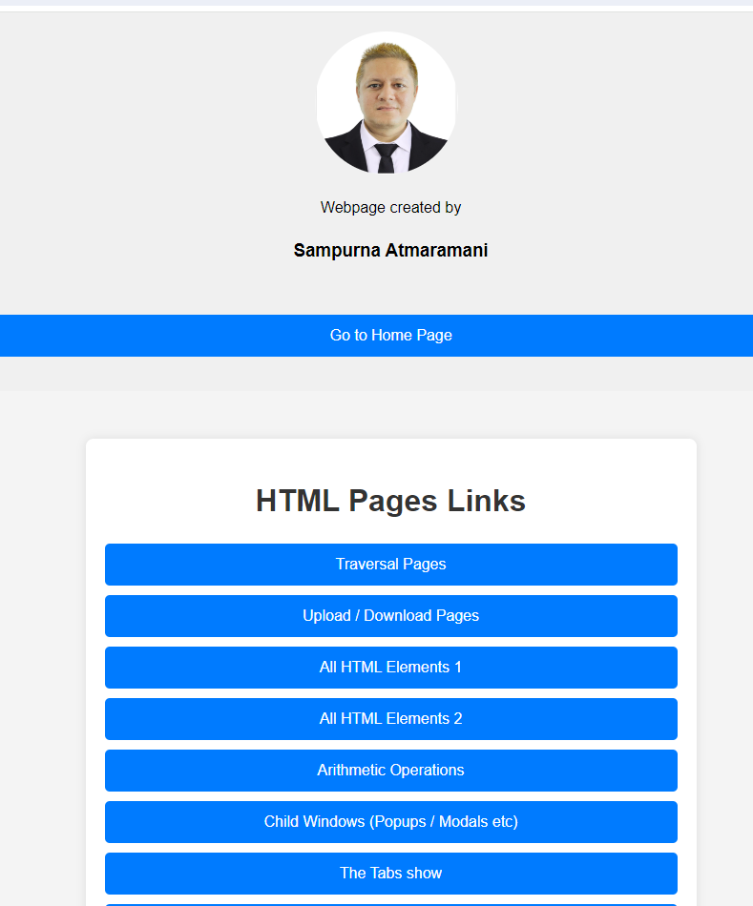
Contents generated from
Own Creations
Wrote Separate Node JS API for proving login scenarios using JWT
Created many HTML pages for explaining various scenarios
Wrote more than 650 test cases only for this training
Resources found from Google / Internet
ChatGPT / Gemini https://playwright.dev Documentation page

Slide 11

Contents

Slide 12
Course Contents
Installing Playwright and related tools i.e. Node, npm, vscode editors etc
Install necessary VS code plugins
Theoretical explanation of the concepts
Practical’s & hands on
Running the tests from various modes (command line, ui, VS code plugins etc)
Using tags to run specific test cases only
Running tests in all or selected browsers

Slide 13
Course Contents
Running whole test file
Running playwright in headed and headless mode (with and without browser)
Running playwright in different viewport like mobile OR IPAD etc

Slide 14
Course Contents
Playwright with various configurable options
From Command Line
From conf file i.e. playwright.config.js
Debugging from command line i.e. –debug
Debugging using page.pause()

Slide 15
Course contents
How to upload and download files using playwright
Intercepting API / URL request & Response
Modifying the request and response i.e. mocking
With one worker and multiple workers (Parallelism)

Slide 16
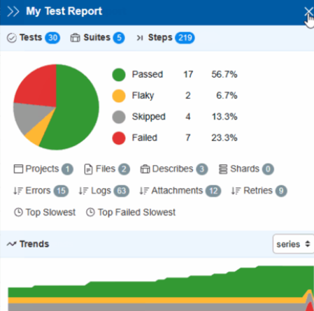
Course contents - reporting
With different type of in built reporting
HTML
JSON
Dot
Line
List

Slide 17
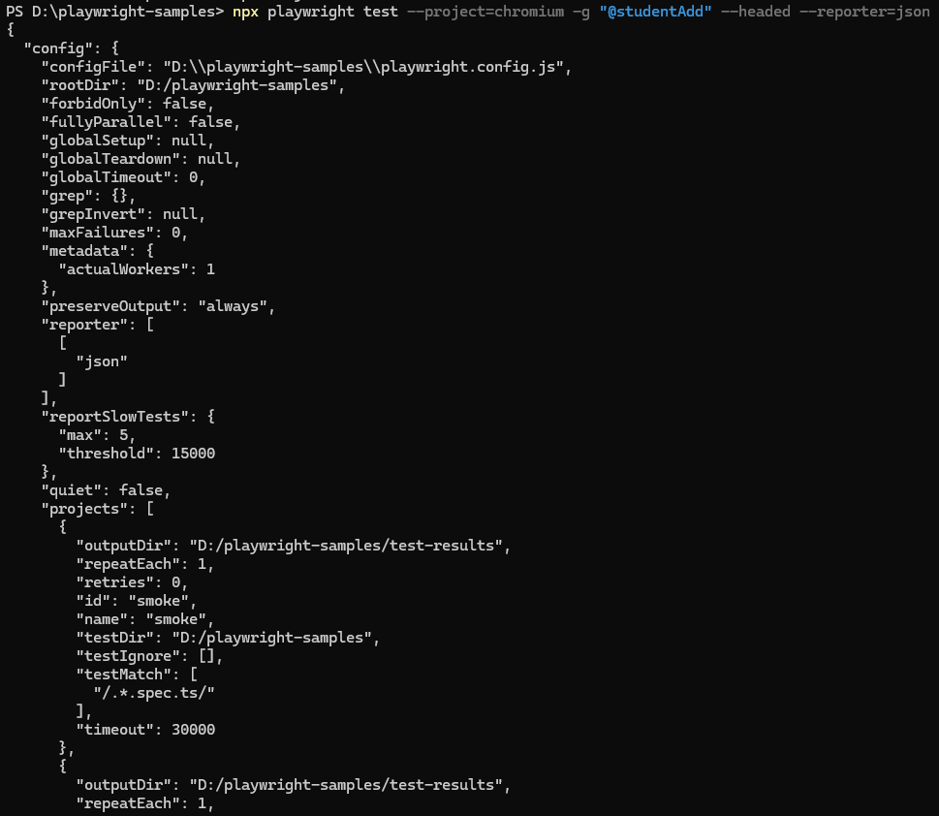

Slide 18
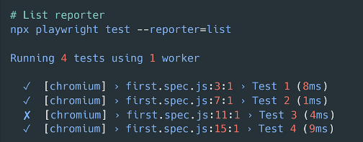
List reporter

Slide 19
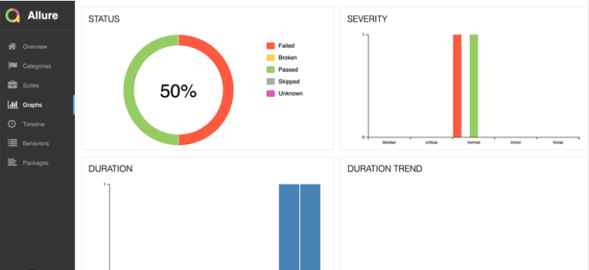
Third Party Reporting
Allure
Argos Visual Testing
Currents
Monocart
ReportPortal
Serenity/JS
Testmo
Testomat.io
Tesults

Slide 20
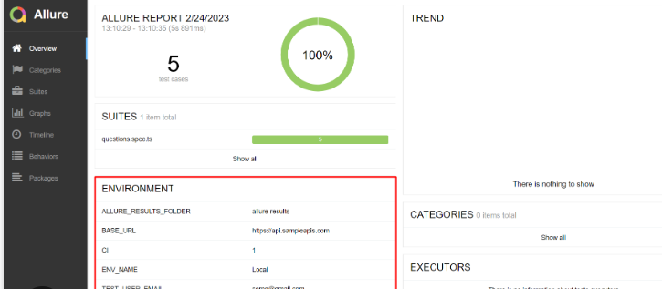
allure

Slide 21
Course contents
Running tests in slow motion
Running tests in trace mode – creates trace.zip
Take screenshots
Record videos
Running in debug mode
Detailed Debugging using Playwright environment variables

Slide 22
Course contents
Interaction with dialog boxes
Alert boxes
Popups / new page opening
Urls opening in new tab, new window even will show hack which will transition from chrome to webkit browser for opening new page
i.e. parent window Chrome
Child window Webkit

Slide 23
Course contents
API Testing
Working with external API using playwright
Getting JWT Token using API request
Handling logged in non logged in users
Restricted page mgt etc

Slide 24
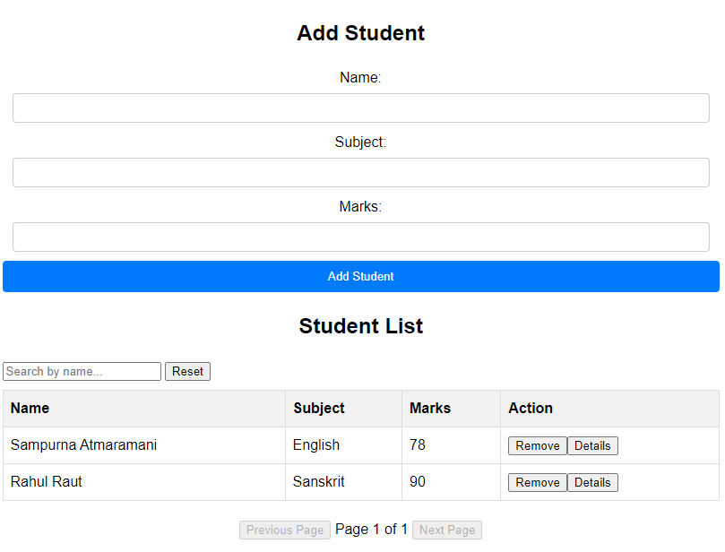
Course contents - Student mgt project
Add student
List student
Search
Pagination (Next and Previous page)
Remove the student record
Display any specific record in alert box
Count number of records
Assertion of everything

Slide 25

What is playwright

Slide 26
Introduction - Playwright
Playwright is an open-source Node.js library for automating web browsers.
It provides a high-level API for automating actions in Chromium, Firefox, and WebKit browsers.
Playwright supports cross-browser testing, enabling developers to write tests once and run them across multiple browsers.
It offers powerful features such as browser context isolation, automatic waiting, and robust debugging capabilities.
Playwright is developed and maintained by Microsoft,providing comprehensive documentation and active community support.
launched on 31 January 2020 (Just 4 years back)

Slide 27
Playwright
Playwright offers a high-level API for tasks like clicking buttons, filling forms, and navigating pages.
Playwright is widely used for web testing, web scraping, and browser automation tasks.

Slide 28


Comparision

Slide 29
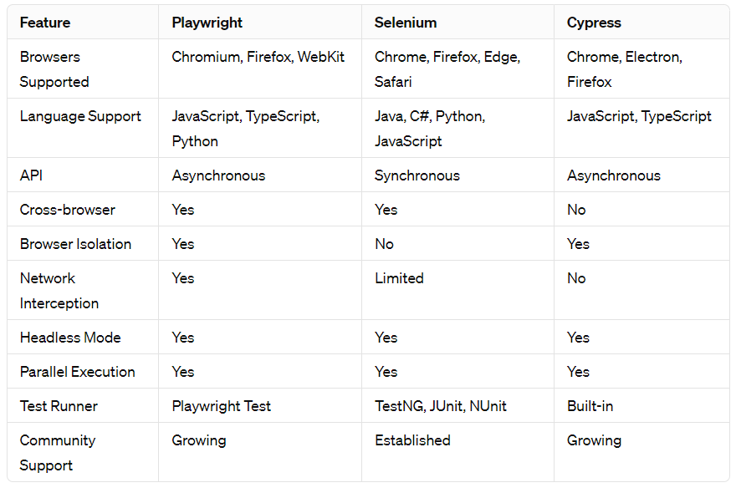
Comparision – Playwright /Selenium / Cypress

Slide 30
Features
Cross-Browser Support: Playwright supports multiple browsers, including Chromium, Firefox, and WebKit, ensuring comprehensive browser coverage for testing.
Unified API: It offers a unified API for automating web interactions across different browsers, making it easy to write and maintain tests without needing to learn multiple APIs.
Browser Isolation: Playwright provides browser isolation, allowing tests to run in separate browser instances to prevent interference between tests and ensure reliable results.
Network Interception: With built-in support for network interception, Playwright enables developers to mock network requests, intercept responses, and simulate various network conditions during testing.

Slide 31
Playwright Features
Headless and Headful Mode: It supports both headless and headful modes, allowing tests to run in the background (headless) or with a visible browser window (headful), depending on the testing requirements.
Parallel Execution: Playwright enables parallel execution of tests across multiple browsers and devices, optimizing test execution time and improving overall efficiency.
DevTools Integration: It offers seamless integration with browser DevTools, allowing developers to debug and inspect test execution, analyze performance metrics, and troubleshoot issues effectively.
Community and Ecosystem: Playwright boasts a growing community of developers and contributors, along with an expanding ecosystem of plugins, integrations, and resources to support testing needs.

Slide 32

Quiz Time

Slide 33
Quiz
True OR false :- Playwright allows third party reporting
True
True or False :- Its not possible to take screenshots in Playwright
False
True of False :- Playwright have Electron browser also in built
False

Slide 34
Quiz
True OR false :- Playwright has different API’s for all 3 different browsers
False
True or False :- Playwright runs on only Headed mode (always opens browser)
False
True of False :- We can intercept Network request and response using Playwright
True

Slide 35
Installation

Slide 36
Installation
Install node JS
Install NPM
Install Playwright –> npm install playwright
Create new project
npm init –y
Install any editor, preferably VS Code

Slide 37
Version Check and Upgrade
npx playwright –version
npm install -D @playwright/test@latest
# Also download new browser binaries and their dependencies: npx playwright install --with-deps

Slide 38
System requirements​
Node.js 18+
Windows 10+, Windows Server 2016+ or Windows Subsystem for Linux (WSL).
MacOS 12 Monterey, MacOS 13 Ventura, or MacOS 14 Sonoma.
Debian 11, Debian 12, Ubuntu 20.04 or Ubuntu 22.04, with x86-64 or arm64 architecture.

Slide 39
Test Objects & Utilities

Slide 40
Objects & Utilities
The @playwright/test package provides several utilities and objects that you can use to write and organize your tests effectively.
ex. const {test, expect} = require(“@playwright/test”);
test: The test function is used to define individual test cases.
expect: The expect function is used for assertions within test cases.

Slide 41
Objects & Utilities
beforeEach: The beforeEach hook is used to run setup code before each test case.
Ex. launching the browser
afterEach: The afterEach hook is used to run teardown code after each test case.
Ex. clean up the test environment
describe: The describe function is used to group related test cases together.
context: The context object provides information about the current test context, including the browser instance and the current page.

Slide 42
Objects & Utilities
beforeAll: The beforeAll hook is used to run setup code once before all test cases. It's often used for expensive operations that only need to be performed once, such as launching the browser or setting up test data.
afterAll: The afterAll hook is used to run teardown code once after all test cases. It's often used to clean up resources that were set up in the beforeAll hook.

Slide 43
locator

Slide 44
What is Locator
A locator in Playwright is a mechanism used to find and interact with elements on a web page.
It helps identify elements based on different attributes like CSS selectors, XPath expressions, text content, or other properties.
CSS Selector for <button class="submitClass“ id=“submitID”>Submit</button>
Syntax: page.locator(selector)
Example: page.locator('button. submitClass’) OR page.locator('button#submitID ‘) OR
Page.locator(“#submitID”)

Slide 45
XPath Expression:
<input type="text" id="username" name=“nameUser" placeholder="Enter your username">
Syntax:
page.locator('your_xpath_expression' )
Example:
page.locator('//input[@id="username"]’ )
Page.locator(“//input[@name= nameUser’]”);

Slide 46
CSs Selectors
CSS Selectors: CSS selectors are patterns used to select the elements you want to style on a web page. They can target elements based on their type, class, ID, or relationship with other elements.
div: Selects all <div> elements.
.classname: Selects all elements with the specified class.
#id: Selects the element with the specified ID.
element1 element2: Selects all element2 elements inside element1.

Slide 47
Text Content:
<button>Submit</button>
Syntax: page.locator('text=Your Text')
Example: page.locator('text=Submit')

Slide 48
Attribute Value:
Attribute Selectors: Attribute selectors allow you to select elements based on the presence or value of their attributes.
<input type="text" name="username" placeholder="Enter your username">
Syntax: page.locator('[attribute="value"]')
Example: page.locator('[name="username"]')

Slide 49
Attribute selection
[name]: Selects all elements with a name attribute.
[name="value"]: Selects all elements with a name attribute equal to 'value'.
[name^="value"]: Selects all elements with a name attribute starting with 'value'.
[name$="value"]: Selects all elements with a name attribute ending with 'value'.
[name*="value"]: Selects all elements with a name attribute containing 'value' anywhere within the attribute value.

Slide 50
Page.$ and page.$$
page.$() and page.$$() are functions used to find elements within the current page context.
They are similar to document.querySelector() and document.querySelectorAll() in the browser's JavaScript environment.
Page.$ and page.$$ is same as page.locator
page.$(“#userid”) => returns one element or null if not found (in case of multiple elements, then returns only first element)
page.$$(“.userClass”) => returns all elements in array format Or empty array if not found

Slide 51
Code Examples
Page.$ example
npx playwright test --project=chromium -g "@page.singledollar" --headed
Page.$$ example
npx playwright test --project=chromium -g "@page.doubledollar1" --headed
npx playwright test --project=chromium -g "@page.doubledollar2" --headed

Slide 52
Chaining – first, last, nth

Slide 53
Chaining – first, last, nth
<input type="text" name="username" placeholder="Enter your username">
<input type="text" name="username" placeholder="Enter your username">
<input type="text" name="username" placeholder="Enter your username">
<input type="text" name="username" placeholder="Enter your username">
const firstInput = page.locator('input[name="username"]').first();
const lastInput = page.locator('input[name="username"]').last();
const secondInput = page.locator('input[name="username"]').nth(2); //starts from 0
npx playwright test --project=chromium -g "@chaining" --headed

Slide 54
Basic Commands

Slide 55
Basic Commands
npx playwright init:
Initializes a new Playwright project in the current directory.
npx playwright codegen <URL>: OR npx playwright codegen
Generates code snippets based on interactions with a web page.
npx playwright install:
Installs dependencies required for Playwright projects.

Slide 56
Commands
npx playwright test:
Runs tests using Playwright.
npx playwright show-report:
Opens the HTML report of test results in the default browser.
6. npx playwright test –ui
Run your tests with UI Mode for a better developer experience with time travel debugging, watch mode and more.

Slide 57
Basic Commands
npx playwright test –debug (dash dash debug)
Opens playwright tests in debug mode
npx playwright test –project=chromium –workers=2
Opens playwright tests on chrome browser with 2 workers (parallel testing & Fast Execution)
npx playwright test --project=chromium -g "@recordvideo" --headed --workers=2
Start playwright tests with trace mode on , only run tests having tags as @recordvideo

Slide 58
Quiz Time

Slide 59
Quiz
True or False :- chaining starts from 1 (number one)
False
True of False :- We need to compulsorily run our code on all the available browsers
False
True OR false :- We can do tagging and run only selected test cases
True

Slide 60
Files structure
After installation

Slide 61
Installed files & Folders
playwright.config.js package.json package-lock.json tests/ example.spec.js tests-examples/ demo-todo-app.spec.js

Slide 62
Hands On
1. Create a Test File:
Create a new file for your test script.
For example, you can name it firstTest.spec.js
2. Write Your Test:
Inside the test file, import the necessary functions and objects from Playwright and write your test logic.
Here's an example of a simple test that navigates to a web page and verifies the page title:

Slide 63
Sample First test script
const { test, expect } = require('@playwright/test');
test('My First Test', async ({ page }) => {
await page.goto('https://example.com');
expect(await page.title()).toBe('Example Domain’);
OR
await expect(page).toHaveTitle('Example Domain’);
});
Run the above script
npx playwright test tests/firstTest.spec.js

Slide 64
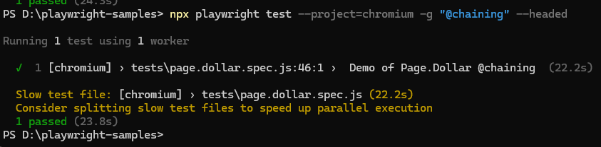
Review the Results: After running the test, you'll see the test results in the terminal.
Playwright will indicate whether the test passed or failed, along with any relevant information or error messages.

Slide 65
Test Case structure

Slide 66
Important Blocks
Setup Block:
Action Block:
Assertion Block:
Cleanup Block:
Teardown Block

Slide 67
Setup Block
This block is where you set up the test environment, including initializing resources, configuring the test environment, and preparing the system under test (SUT) for testing.
Example tasks:
Launching the browser.
Opening a new page.
Setting up test data.
Navigating to a specific URL.

Slide 68
Action Block:
This block contains the actions or operations that you perform on the SUT during the test.
Example tasks:
Clicking on elements.
Filling in forms.
Interacting with UI components.
Making API requests.

Slide 69
Assertion Block:
This block contains the assertions or checks that verify whether the test behaves as expected.
Example tasks:
Verifying text content.
Checking element visibility.
Asserting element attributes.
Validating API responses.

Slide 70
Cleanup Block:
This block is responsible for cleaning up the test environment and resources after the test completes, ensuring that the system is left in a consistent state.
Example tasks:
Closing the browser.
Resetting test data.
Releasing resources.
Logging test results.

Slide 71
Teardown Block (Optional):
Playwright provide a teardown block, which is executed after each test case or test suite, regardless of whether the test passed or failed. It's typically used for additional cleanup tasks.
Example tasks:
Closing database connections.
Resetting global state.
Performing additional cleanup actions.

Slide 72
Test script structure
In a basic test script using Playwright, you can expect to find the following elements:
Imports: Import necessary functions and objects from Playwright or other libraries.
const { test, expect } = require('@playwright/test');

Slide 73
Test Declaration
Define your test cases using the test function provided by Playwright.
test('Test Description', async ({ page }) => {
// Test logic goes here
});

Slide 74
Test Logic
Write the logic for your test case inside the test function. This may include navigating to web pages, interacting with elements, making assertions, etc.
test('Login Test', async ({ page }) => {
await page.goto('https://example.com');
// Perform login actions
// Assert login success
});

Slide 75
Assertions
Use the expect function to make assertions about the behavior of your application.
test('Login Test', async ({ page }) => {
await page.goto('https://example.com');
const pageTitle = await page.title();
expect(pageTitle).toBe('Example Domain');
});

Slide 76
Hooks Setup and Teardown
Optionally, you can include setup and teardown logic before and after each test case using beforeEach and afterEach hooks.
beforeEach(async ({ page }) => {
// Setup logic goes here
});
afterEach(async ({ page }) => {
// Teardown logic goes here
});

Slide 77
Environment configuration

Slide 78
Environment Configuration
You may configure the test environment, such as browser settings, geolocation, locale, viewport size, etc.
use({
...devices['iPhone 12 Pro Max'],
locale: 'en-US',
geolocation: { longitude: 10.0, latitude: 20.0 },
});

Slide 79
NAvigation

Slide 80
navigation
Most of the UI tests will start with navigating page to the URL
await page.goto(<URL>);
await page.goto('https://playwright.dev/’);

Slide 81
Interactions

Slide 82
Interactions
Performing actions starts with locating the elements.
Playwright uses Locators API for that. Locators represent a way to find element(s) on the page at any moment
<a href=“google.com”>Get started</a>
// Create a locator. const getStarted = page.getByRole('link', { name: 'Get started' }); // Click it. await getStarted.click();

Slide 83
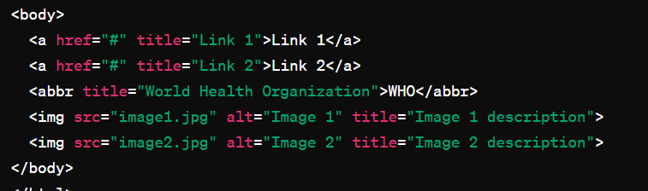
Get By ….
getByRole: Finds an element based on its role attribute, such as "button" or "link".
getByText: Finds an element containing the specified text.
getByTestId: Finds an element by its data-testid attribute.
getByTitle: Finds an element by its title attribute.
getByAltText: Finds an element by its alt attribute, commonly used for images.

Slide 84
Basic actions
Action | Description
locator.check() | Check the input checkbox
locator.click() | Click the element
locator.uncheck() | Uncheck the input checkbox
locator.hover() | Hover mouse over the element
locator.fill() | Fill the form field, input text
locator.focus() | Focus the element
locator.press() | Press single key
locator.setInputFiles() | Pick files to upload
locator.selectOption() | Select option in the drop down

Slide 85
Actionability Checks
Playwright smartly perform checks these before taking action

Slide 86
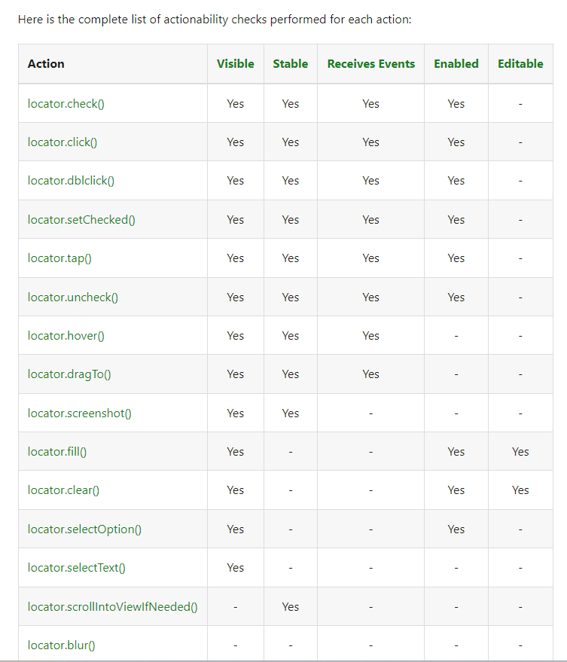

Slide 87
assertions

Slide 88
Assertions
expect(success).toBeTruthy();
await expect(page).toHaveTitle(“Playwright”);
OR
await expect(page.title()).toBe(“Playwright”);

Slide 89
assertions
Assertion | Description
expect(locator).toBeChecked() | Checkbox is checked
expect(locator).toBeEnabled() | Control is enabled
expect(locator).toBeVisible() | Element is visible
expect(locator).toContainText() | Element contains text
expect(locator).toHaveAttribute() | Element has attribute
expect(locator).toHaveCount() | List of elements has given length
expect(locator).toHaveText() | Element matches text
expect(locator).toHaveValue() | Input element has value
expect(page).toHaveTitle() | Page has title
expect(page).toHaveURL() | Page has URL

Slide 90
Test ISOlation

Slide 91
Test Isolation
Pages are isolated between tests due to the Browser Context, which is equivalent to a brand new browser profile, where every test gets a fresh environment, even when multiple tests run in a single Browser.
This isolation between tests provides several benefits, including:
Improved reliability: Each test runs in a clean environment, reducing the likelihood of interference from external factors or dependencies.
Parallel execution: Tests can be executed in parallel, as they do not depend on shared resources or state.
Clear separation of concerns: Each test case is self-contained and independent, making it easier to understand and maintain the test suite.

Slide 92
One file, multiple browser instances
import { test } from '@playwright/test'; test('example test', async ({ page }) => { // "page" belongs to an isolated BrowserContext, created for this specific test. });
//This should open another browser with fresh start test('another test', async ({ page }) => { // "page" in this second test is completely isolated from the first test. });

Slide 93
Hooks

Slide 94
Hooks
You can use various test hooks such as test.describe to declare a group of tests and test.beforeEach and test.afterEach which are executed before/after each test.
Other hooks include the test.beforeAll and test.afterAll which are executed once per worker before/after all tests.

Slide 95
Hooks
test.describe('navigation', () => { test.beforeEach(async ({ page }) => { // Go to the starting url before each test. await page.goto('https://playwright.dev/’);
}) test('main navigation', async ({ page }) => { // Assertions use the expect API. await expect(page).toHaveURL('https://playwright.dev/’); }); });
});

Slide 96
Hooks
Hooks in Playwright are functions that allow you to perform setup and teardown actions before and after test cases or test suites.
beforeAll: This hook runs once before all test cases in a test suite. It is typically used for global setup tasks that need to be performed once before any tests are executed.
beforeEach: This hook runs before each individual test case in a test suite. It is commonly used to set up a clean test environment or perform initialization steps specific to each test.

Slide 97
Hooks
afterEach: This hook runs after each individual test case in a test suite. It is used to clean up resources or perform teardown actions that are needed after each test.
afterAll: This hook runs once after all test cases in a test suite have been executed. It is used for global teardown tasks or cleanup actions that need to be performed once after all tests have finished.

Slide 98
Quiz Time

Slide 99
Quiz
Question: What is the purpose of the page.goto function in a test script?
Answer: The page.goto function navigates the browser to a specified URL, allowing us to start our test from a specific web page.

Slide 100
Quiz
Question: How do you make assertions about the behavior of your application in a Playwright test script?
Answer: expect

Slide 101
Quiz
Question: What is the purpose of the beforeEach and afterEach hooks in a Playwright test script?
Answer: These hooks allow you to execute setup and teardown logic before and after each test case, ensuring a clean and consistent test environment.

Slide 102
Quiz
Question: Give me a command to execute a Playwright test script using the Playwright CLI (Command Line)
Answer: npx playwright test

Slide 103
Playwright API

Slide 104
Playwright API
The Playwright API provides a comprehensive set of functionalities for automating browser interactions. Here's an overview of some key features:
Browser Management: Playwright allows you to launch and manage browser instances programmatically. You can control various browser options such as headless mode, viewport size, user agent, and more.
Page Navigation: With Playwright, you can navigate through web pages by loading URLs, clicking on links, filling out forms, and interacting with various elements such as buttons, inputs, and dropdowns.
Element Selection and Interaction: Playwright provides methods to locate and interact with HTML elements on the page. You can find elements by CSS selectors, XPath expressions, or using other attributes. Once located, you can interact with elements by clicking, typing text, hovering, or performing other actions.

Slide 105
Playwright API
Keyboard and Mouse Actions: Playwright allows you to simulate keyboard and mouse actions, such as typing text, pressing keys, moving the mouse cursor, and performing drag-and-drop operations.
Assertions and Expectations: Playwright includes built-in assertion methods for verifying the state of the web page during test execution. You can check element visibility, text content, attribute values, and more to ensure that your application behaves as expected.
Intercepting Network Requests: Playwright enables you to intercept and modify network requests and responses. This feature is useful for testing applications that rely on APIs or backend services, allowing you to mock responses, simulate network conditions, or capture network activity for analysis.
Browser Contexts and Cookies: Playwright supports multiple browser contexts, allowing you to isolate cookies, caches, and other browser state between different test scenarios. This feature is helpful for testing user authentication, session management, and other scenarios where maintaining separate browser contexts is necessary.

Slide 106
Playwright API
Screenshots and Videos: Playwright provides APIs for capturing screenshots and recording videos of test executions. You can use these features to create visual documentation, debug failing tests, or share test results with stakeholders.
Error Handling and Debugging: Playwright offers robust error handling mechanisms and debugging tools to help you diagnose and troubleshoot issues in your test scripts. You can log messages, handle exceptions, and inspect browser console output to identify problems and optimize test performance.
Integration with Testing Frameworks: Playwright integrates seamlessly with popular testing frameworks such as Jest, Mocha, and Jasmine. You can write and execute Playwright tests within your existing test suites, leveraging the features and capabilities of your preferred testing framework.

Slide 107
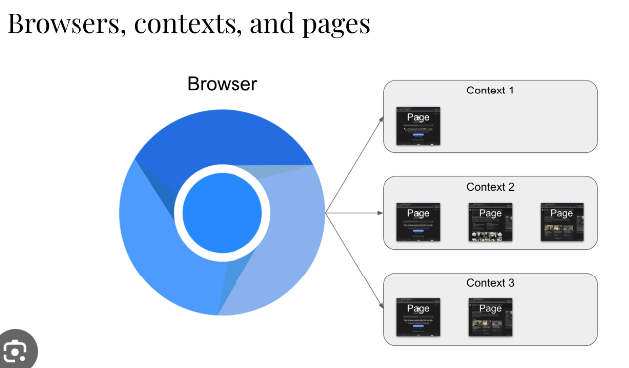
Representation

Slide 108
Browser Context
A browser context represents an isolated browsing session within a browser instance.
Each browser context has its own set of cookies, local storage, caches, and other browser state.
Browser contexts are useful for simulating different user scenarios or testing authentication mechanisms.
You can create multiple browser contexts within a single browser instance to run parallel tests or handle different user sessions separately.

Slide 109
Pages

Slide 110
Pages
A page is a single tab or window within a browser context that displays a web page.
You can interact with pages to navigate to URLs, interact with elements, and perform various actions.
Pages expose methods for interacting with the DOM, including clicking elements, typing text, and evaluating JavaScript expressions.
Playwright provides APIs for creating, closing, and managing pages within browser contexts dynamically.

Slide 111
Elements

Slide 112
Elements
Elements represent individual HTML elements on a web page, such as buttons, inputs, or divs.
You can locate elements using CSS selectors, XPath expressions, or other attributes.
Once located, elements provide methods for interacting with them, such as clicking, typing text, or retrieving attribute values.

Slide 113
Navigation Methods

Slide 114
Navigation Methods:
Playwright provides several methods for navigating between pages:
page.goto(url): Navigates to the specified URL. You can optionally provide navigation options such as timeout, waitUntil, and referer.
page.goBack(): Navigates to the previous page in the browser history.
page.goForward(): Navigates to the next page in the browser history.
page.reload(): Reloads the current page.

Slide 115
Navigation events

Slide 116
Navigation Events
Playwright emits various navigation-related events that you can listen for and handle in your tests:
page.on('navigation', handlerFn): Fired when the page navigates to a new URL.
page.on('load', handlerFn): Fired when the page's load event is triggered, indicating that all resources have finished loading.
page.on('domcontentloaded', handlerFn): Fired when the DOM content of the page is fully loaded, but not necessarily all resources like images or scripts.
page.on('frameattached', handlerFn): Fired when a new frame is attached to the page.

Slide 117
Navigation control

Slide 118
Navigation Control:
You can control navigation behavior using various options and settings:
Timeout : Specifies the maximum time to wait for navigation to complete before throwing an error.
Maximum operation time in milliseconds. Defaults to 0 - no timeout
waitUntil : Defines when to consider navigation successful, such as when the page's load event fires or when the DOM content is loaded.
waitUntil "load"|"domcontentloaded"|"networkidle"|"commit" (optional)#
referer: Sets the Referer HTTP header for the navigation request.

Slide 119
Navigating to URLs & Waiting

Slide 120
Navigating to URLs:
Playwright allows you to navigate to specific URLs using the page.goto(url[, options]) method. You can provide the URL as the first argument and optionally specify navigation options such as timeout, waitUntil, and referer.
Waiting for Navigation:
After initiating a navigation, you can wait for the page to complete loading using the page. page.waitForURL([options]) method. This method allows you to wait until the navigation is complete, and the page has stabilized before proceeding with further actions.

Slide 121
Waiting for Page content
Sometimes, you may need to wait for specific content to appear on the page before continuing with your tests. Playwright provides methods like page.waitForSelector(selector[, options]) and page.waitForFunction(predicate[, options]) to wait for elements or conditions to become visible or satisfied.
Handling Navigation Events:
Playwright emits various navigation-related events that you can listen for and handle in your tests. For example, you can use the page.on('load', handler) event to detect when the page's load event is triggered, indicating that all resources have finished loading.
Reload and Navigation History:
Playwright also allows you to reload the current page using the page.reload([options]) method. Additionally, you can navigate backward and forward in the browser's navigation history using the page.goBack([options]) and page.goForward([options]) methods, respectively.

Slide 122
Listening to events

Slide 123
Listening to Navigation Events:
Playwright provides the page.on(event, handler) method to listen for navigation events. You can use this method to register event listeners for events such as load, domcontentloaded, error, framenavigated, etc.
// Listen for the 'load' event
page.on('load', () => {
console.log('Page loaded successfully');
});

Slide 124
domcontentloaded
// Listen for the 'domcontentloaded' event
page.on('domcontentloaded', () => {
console.log('DOM content loaded');
});

Slide 125
error
// Listen for the 'error' event
page.on('error', (err) => {
console.error('Navigation error:', err);
});

Slide 126
framenavigated
// Listen for the 'framenavigated' event
page.on('framenavigated', (frame) => {
console.log('Frame navigated:', frame.url());
});

Slide 127
Handling Page Load:
You can use the 'load' event to determine when the page has finished loading.
This event is triggered when the load event of the page is fired, indicating that all resources (including stylesheets, images, and scripts) have been loaded.

Slide 128
Handling DOM Content Loaded:
The 'domcontentloaded' event occurs when the initial HTML document has been completely loaded and parsed, without waiting for stylesheets, images, and subframes to finish loading.

Slide 129
Handling Errors:
The 'error' event is triggered when an error occurs during navigation, such as a network error or a page load timeout.
You can use this event to handle navigation failures gracefully.

Slide 130
Handling Frame Navigation:
Playwright also emits the 'framenavigated' event whenever a frame within the page is navigated to a new URL.
This allows you to track changes in the page's frame structure.

Slide 131
Waiting for element

Slide 132
Waiting for Element Availability:
Use waitForSelector() to wait for an element to appear, be visible, or reach a specific state before interacting with it. This helps handle dynamic content loading and ensures element availability.
<button class=‘someclass”>Submit</button>
Page.waitForSelector(“.someclass”).click();

Slide 133
await page.goto('https://example.com');
const element = await page.waitForSelector('h1');
console.log('Element found:', element);

Slide 134
Retrieving info

Slide 135
Retrieving Element Properties:
You can retrieve various properties of an element, such as its text content, attributes, visibility status, bounding box, etc., using methods like innerText(), getAttribute(name), isVisible() etc.
await page.goto('https://example.com’);
const element = await page.$(‘.textInput’);
const textContent = await element.textContent();

Slide 136
Retriving info
const element = await page.$('a’);
const hrefAttributeValue = await element.getAttribute('href’);
console.log('Href Attribute Value:', hrefAttributeValue);

Slide 137
Element state

Slide 138
Handling Element State:
Playwright provides methods to check and modify the state of elements, such as isChecked() and setChecked() for checkboxes, isSelected() and selectOption() for dropdowns, etc.

Slide 139
Clicking on elements

Slide 140
Clicking on Elements:
Use the click() method to simulate a mouse click on an element.
Option 1
await page.click(‘#button'); // Clicks a button having id=button
Option 2
Await page.locator(“#button”).click()

Slide 141
Insert text

Slide 142
Typing Text:
Use the fill(text) method to simulate typing text into input fields, text areas, or other editable elements.
await page.fill('input[type="text"]', 'Hello, World!'); // Types text into a text input field
Await page.fill(“#username”, “Some Value”);
Await page.locator(“#username”).fill(“Some Value here”);

Slide 143
Hover

Slide 144
Hovering Over Elements:
Use the hover() method to simulate hovering over an element. This can trigger hover-related effects like dropdown menus.
await page.hover('a.dropdown-toggle'); // Hovers over a dropdown menu trigger

Slide 145
checkboxes

Slide 146
Interacting with Checkboxes and Radio Buttons:
Use methods like check() and uncheck() to interact with checkboxes, and radioButton.click() to interact with radio buttons.
await page.check('input[type="checkbox"]'); // Checks a checkbox
await page.uncheck('input[type="checkbox"]'); // Unchecks a checkbox
Await page.locator(“someLocator”).check();

Slide 147
selecting dropdown option

Slide 148
Selecting Options in Dropdowns:
Use the selectOption() method to select an option in a dropdown menu.
await page.selectOption('select#dropdown', 'Option 1'); // Selects 'Option 1' from a dropdown menu
Await page.locator(“SomeLocator”).selectOption(“What To Select”)

Slide 149
scrolling

Slide 150
Scrolling:
Use the scrollIntoView() method to scroll an element into view.
const element = await page.locator('#target-element');
await element.scrollIntoView(); // Scrolls the element into view

Slide 151
Keyboard shortcuts

Slide 152
Simulating Keyboard Shortcuts:
Use the keyboard.press(key) method to simulate pressing a keyboard key.
await page.keyboard.press('Enter'); // Simulates pressing the Enter key
await page.keyboard.press('Enter+Shift+Alt’);
Shortcuts such as key: "Control+o", key: "Control++ or key: "Control+Shift+T" are supported as well.

Slide 153
Waiting for elements

Slide 154
waitForXPath():
If you're using XPath selectors, you can use waitForXPath() to wait for an element matching the XPath expression.
await page.waitForXPath('//button[@id="submit-button"]');

Slide 155
waitForTimeout():
Use waitForTimeout() to introduce a delay in milliseconds before proceeding with the test.
await page.waitForTimeout(2000); // Waits for 2 second

Slide 156
waitForFunction():
You can use waitForFunction() to wait until a given function returns a truthy value.
await page.waitForFunction(() => document.querySelector('button') !== null);

Slide 157
waitForLoadState():
Use waitForLoadState() to wait until the page reaches a specific load state, such as 'load' or 'networkidle'.
await page.waitForLoadState('networkidle');

Slide 158
waitForEvent():
Playwright allows you to wait for specific events to occur on the page, such as 'navigation', 'dialog', or 'download'.
await page.waitForEvent('navigation');

Slide 159
Quiz Time

Slide 160
Quiz - Playwright API Overview:
Question: What is Playwright?
Answer: Playwright is an open-source Node.js library for automating browsers developed by Microsoft. It allows developers to write reliable end-to-end tests for web applications across different browsers.

Slide 161
Quiz
Question: Name three key features of Playwright.
Answer: Playwright offers cross-browser support, automation of complex user interactions, and access to low-level browser APIs for advanced testing scenarios.

Slide 162
Quiz
Question: How does Playwright differ from other testing frameworks like Selenium and Cypress?
Answer: Playwright provides more advanced features, such as support for multiple browsers, built-in parallel test execution, and access to browser devtools. It also offers better reliability and stability compared to Selenium and Cypress.

Slide 163
Quiz - Browser Contexts
Question: What is a browser context in Playwright?
Answer: A browser context in Playwright represents an isolated browsing session, including cookies, storage, and permissions. It allows for parallel testing and isolation of different test scenarios.

Slide 164
Quiz - Navigation:
Question: How can you navigate to a URL in Playwright?
Answer: You can navigate to a URL in Playwright using the page.goto() method of a page object.

Slide 165
Quiz – load State
Question: How can you wait for a specific load state in Playwright?
Answer: You can wait for a specific load state in Playwright using the waitForLoadState() method of a page object.

Slide 166
Quiz - Loading Pages:
Question: What does it mean for a page to be in a 'load' or 'networkidle' state?
Answer:
Load = when it is actively loading resources
'networkidle = when there are no more network connections after a period of time.

Slide 167
Quiz - Interacting with Elements:
Question: What are some common user actions you can perform with elements in Playwright?
Answer: Common user actions in Playwright include clicking, typing, hovering, scrolling, and querying element properties.
Question: which function will you use to insert data in textbox
Answer: fill()
Question: Describe a situation where interacting with elements is essential in test automation.
Answer: Interacting with elements is essential in test automation for simulating user interactions, such as filling out forms, clicking buttons, and verifying the presence of specific elements on a page.

Slide 168
Quiz - Clicking, Typing, and Other User Actions:
Question: How can you simulate a click on an element in Playwright locator having id = someId ?
Answer:
page.locator(“#someId”).click();
Page.click(“#someId”);

Slide 169
Quiz - Waiting for Elements:
Question: Why is waiting for elements important in test automation?
Answer: Waiting for elements is important in test automation to ensure that the page has finished rendering and the elements are available for interaction.

Slide 170
Advanced Interactions and Assertions

Slide 171
Advanced User Interactions
actions such as drag and drop, keyboard shortcuts, mouse actions like hovering and right-clicking, file upload etc

Slide 172
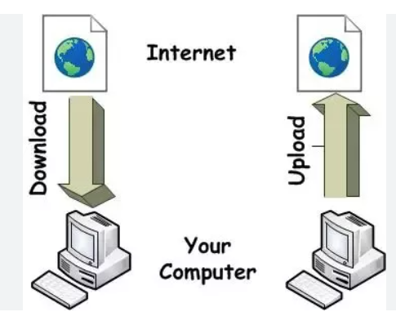
File upload & Download
File uploads and downloads in Playwright refer to the capability of interacting with file input elements to upload files
With Playwright, testers can automate file upload and download processes to ensure the reliability and functionality of web applications.

Slide 173
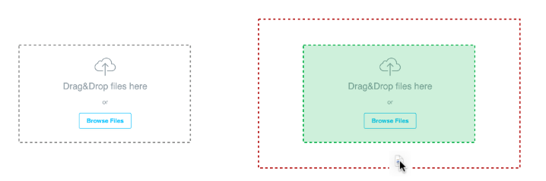
Drag-and-drop
Drag-and-drop Interaction: Drag-and-drop is a common user interaction pattern where users click and hold on an element, drag it to a different location, and then release the mouse button to drop it.
dragTo() Method: This method help s to achieve drag and Drop as below
await page.locator("#dragElement").dragTo(page.locator("#dropTarget"));

Slide 174
Drag & Drop code
test('Drag-and-drop Example', async ({ page }) => {
const sourceElement = await page.locator('#source');
const targetElement = await page.locator('#target’);
await page.locator("# source").dragTo(page.locator("# target"));
});
npx playwright test --project=chromium -g "@dragAndDrop" --headed

Slide 175
Keyboard & Mouse Events
Keyboard Events: Keyboard events are actions triggered by pressing or releasing keys on the keyboard. Examples include keydown, keyup, and keypress events.
Mouse Events: Mouse events are actions triggered by interactions with the mouse, such as clicking, hovering, dragging, and dropping.
Keyboard Input: Playwright provides methods to simulate keyboard input, allowing testers to send key presses, text input, and keyboard shortcuts programmatically.

Slide 176
Keyboard & mouse events
Mouse Interaction: clicking, double-clicking, right-clicking, hovering, dragging, and dropping.
Event Triggering: Test scripts can trigger keyboard and mouse events on specific elements or coordinates on the page
Event Handling: Web applications often respond to keyboard and mouse events by triggering actions or updating the UI.
Cross-Browser Compatibility: Playwright's keyboard and mouse event emulation works consistently across different browsers, ensuring consistent behavior across various browser environments.

Slide 177
Assertions & Testing

Slide 178
Assertions
Introduction to Assertions: Assertions are statements that verify whether expected outcomes match actual outcomes during testing. They are essential for validating the behavior of software components.
Integration with Testing Frameworks: Playwright seamlessly integrates with popular testing frameworks such as Jest, Mocha, and Jasmine, allowing developers to write expressive and robust test suites.

Slide 179
assertions
With Jest
expect(await page.title()).toBe('Example Domain’);
With Mocha
assert.equal(title, 'Example Domain');

Slide 180
assertions
Assertion | Description
expect(locator).toBeChecked() | Checkbox is checked
expect(locator).toBeEnabled() | Control is enabled
expect(locator).toBeVisible() | Element is visible
expect(locator).toContainText() | Element contains text
expect(locator).toHaveAttribute() | Element has attribute
expect(locator).toHaveCount() | List of elements has given length
expect(locator).toHaveText() | Element matches text
expect(locator).toHaveValue() | Input element has value
expect(page).toHaveTitle() | Page has title
expect(page).toHaveURL() | Page has URL

Slide 181
Choosing Library
Choosing an Assertion Library: While Jest and Mocha are popular choices, developers can also use other assertion libraries like Chai with Playwright to suit their preferences and project requirements.

Slide 182
Reporting

Slide 183
Test Reporting & CI
In built Reporting
HTML
JSON
LINE
Dot
LIST
Continuous Integration (CI): Playwright's assertion integration ensures that tests accurately reflect the behavior of web applications across different environments.

Slide 184
Third-Party Reporting Libraries:
Allure: HTML reports with rich visualization of test execution results.
Mochawesome: HTML report with detailed test execution information.
Jest HTML Reporter: HTML report with detailed test results.
ReportPortal: ReportPortal is a customizable test reporting and analysis platform
ExtentReports: Generate interactive HTML reports with test execution details.

Slide 185
Writing assertions for various use cases

Slide 186
Verifying Page Title:
Use case: Ensure that the page title matches the expected title.
Assertion: expect(await page.title()).toBe('Expected Title');

Slide 187
Checking Element Visibility:
Use case: Confirm that a specific element is visible on the page.
Assertion: expect(await page.isVisible('.element-class')).toBeTruthy();

Slide 188
Validating Text Content:
Use case: Verify that the text content of an element matches the expected value.
Assertion: expect(await page.textContent('.element-class')).toContain('Expected Text');

Slide 189
Asserting Element Count:
Use case: Ensure that the page contains the expected number of elements matching a selector.
Assertion: expect(await page.$$('.element-class')).toHaveLength(3);

Slide 190
Checking Element State:
Use case: Verify that an element has a specific attribute or property set.
Assertion: expect(await page.evaluate('.element-class', el => el.getAttribute('attribute-name'))).toBe('expected-value');

Slide 191
Validating Element Properties:
Use case: Confirm that an element has specific properties or CSS styles applied.
Assertion: expect(await page.evaluate('.element-class', el => el.style.backgroundColor)).toBe('red');

Slide 192
Asserting Navigation:
Use case: Ensure that navigating to a specific URL results in the expected page content.
Assertion: expect(await page.url()).toBe('https://example.com');

Slide 193
Checking Network Requests:
Use case: Verify that certain network requests are made during page interactions.
Assertion: expect(await page.waitForRequest('https://api.example.com/data')).toBeTruthy();

Slide 194
Validating Form Submissions:
Use case: Confirm that form submissions result in the expected behavior or network requests.
Assertion: expect(await page.waitForResponse('https://api.example.com/submit')).toBeTruthy();

Slide 195
Structuring tests (describe, it blocks)

Slide 196
Describe Block
Structuring tests using describe and it blocks is a common practice in test frameworks like Jest or Mocha, and it can help organize and modularize your test suite.
describe('Login Page', () => {
// Test cases related to login functionality
});

Slide 197
It block
it('Should display an error message for invalid credentials', async () => {
// Test logic to verify error message display
});

Slide 198
Nested Describe Blocks
describe('User Profile', () => {
describe('Editing Profile', () => {
// Test cases related to editing user profile
});
describe('Viewing Profile', () => {
// Test cases related to viewing user profile
});
});

Slide 199
Before and After Hooks:
beforeEach(async () => {
/* Setup logic */
});
afterEach(async () => {
/* Teardown logic */
});

Slide 200
Describe & It blocks with Hooks
describe('User Authentication', () => {
beforeEach(async () => {
// Login before each test case
});
afterEach(async () => {
// Logout after each test case
});
it('Should allow access to authenticated users', async () => {
// Test logic for authenticated access
});
it('Should redirect unauthenticated users to login page', async () => {
// Test logic for unauthenticated access
});
});

Slide 201
quiz

Slide 202
Quiz - Drag-and-drop:
Question: give me the function which helps in drag and drop
Answer: You can use the dragTo(target) method to simulate a drag-and-drop operation. Example: await page.locator("#dragElement").dragTo(page.locator("#dropTarget"));

Slide 203
Quiz - Keyboard and mouse events:
Question: How can you simulate keyboard events such as typing a text using Playwright?
Answer: You can use the page.fill(selector, text) method to simulate typing text into an element.
Example: await page.fill(<SOME_LOCATOR>), 'Hello, World!’).
Await page.locator(<SOME_LOCATOR>).fill(“This is the text”);

Slide 204
Quiz - Assertions and Testing:
Question: Which assertion libraries can you use with Playwright for writing tests?
Answer: You can use libraries like Jest, Mocha, or Chai for writing assertions in Playwright tests.
Question: How do you assert that an element is visible on the page using Playwright?
Answer: You can use the expect function along with Playwright's isVisible method to assert the visibility of an element.
Example: expect(await page.isVisible('.element')).toBeTruthy().

Slide 205
Quiz - Structuring tests (describe, it blocks):
Question: What is the purpose of the describe block in test scripts?
Answer: The describe block is used to group related test cases together.
Question: How can you execute setup and teardown logic before and after each test case in Playwright tests?
Answer: You can use the beforeEach and afterEach hooks to execute setup and teardown logic before and after each test case within the describe block.

Slide 206
Playwright Features Deep Dive

Slide 207
Handling Browser Dialogs:
Playwright provides methods like page.on('dialog') to intercept and handle browser dialogs such as alert, confirm, and prompt.
You can use the intercepted dialog object to accept, dismiss, or provide input to the dialogs.
npx playwright test --project=chromium -g "@dismiss" --headed
npx playwright test --project=chromium -g "@prompt" --headed
npx playwright test --project=chromium -g "@confirm" --headed

Slide 208
Intercepting New Windows or Tabs:
Use page.waitForEvent('popup') to intercept and handle new browser windows or tabs.
This allows you to perform actions on the new page, such as navigating or interacting with elements.
//npx playwright test --project=chromium -g "@openNewWindow" --headed

Slide 209
Dismissing Alert Dialogs:
To dismiss an alert dialog, use the dialog.dismiss() method.
This allows you to handle scenarios where an alert needs to be dismissed without user interaction.
npx playwright test --project=chromium -g "@dismiss" --headed

Slide 210
Working with Frames and Iframes

Slide 211
Navigating to Frames:
Use page.frame(name) or page.frame(url) to navigate to a frame by its name or URL.
You can also use page.frames() to get a list of all frames object on the page.
Iframes.spec.js

Slide 212
Interacting with Elements Inside Frames:
Once inside a frame, you can interact with elements using standard Playwright methods like click(), fill(), etc.
Ensure you switch to the correct frame context using page.frame() before interacting with elements inside it.

Slide 213
Navigating Between Frames:
Use page.waitForUrl() or other navigation methods to wait for frame navigations to complete.
When navigating between frames, ensure you switch to the appropriate frame context using page.frame().

Slide 214
Handling Nested Frames:
Playwright supports nested frames, allowing you to navigate through multiple levels of frames within frames.
Use page.waitForSelector() or other waiting methods to ensure elements inside nested frames are ready before interacting with them.
Ex.
Page.waitForSelector(<SomeSelector>);
Page.waitForSelector(“#StudentID”); //wait for StudentID id to load on the dom HTML

Slide 215
Identifying Frames:
Frames can be identified by their name, index, or URL.
Ensure you specify the correct identifier when switching to a frame using page.frame().

Slide 216
Frame Lifecycle Events:
Playwright emits events like 'frameattached' and 'framedetached' to notify when frames are attached or detached from the page.
You can listen for these events to handle dynamic changes to frame structures during test execution.
npx playwright test --project=chromium -g "@iframe" --headed

Slide 217
Network Interception and Mocking

Slide 218
Intercepting Network Requests:
Playwright provides the page.route(url, handlerFn) method to intercept network requests based on their URL.
You can define a custom handler function to intercept requests and modify their behavior as needed.
The handler function receives the intercepted request, allowing you to inspect and modify its properties, headers, and payload.

Slide 219
Mocking Responses:
With network interception, you can mock responses for intercepted requests to simulate various scenarios.
You can define custom response data

Slide 220
Dynamic Route Handling:
Playwright supports dynamic route handling, allowing you to modify the response based on the intercepted request's properties.
await context.route('**/api/data', route => {
route.fulfill({
status: 200,
contentType: 'application/json',
body: JSON.stringify({ message: 'Mocked data response' })
});
});
You can conditionally respond to requests based on their method, URL, headers, or other criteria defined in the handler function.

Slide 221
Examples of Use Cases:
Mocking API responses to test client-side behavior without relying on actual backend services.
Testing different scenarios such as successful responses, timeouts, or error conditions to ensure robustness.
npx playwright test --project=chromium -g "@mock" --headed

Slide 222
Debugging and Logging:
Playwright provides logging capabilities to debug network interactions during test execution.
You can log intercepted requests and responses to inspect their details and troubleshoot issues during test development.

Slide 223
Defining the Route Handler:
The route handler function receives the intercepted request object as its parameter.
Inside the handler function, you can inspect and modify properties of the intercepted request.
await page.route('**/*.png', route => {
console.log('Intercepted request:', route.request().url());
// Modify request headers, respond with custom data, or abort the request
});

Slide 224
Mocking responses

Slide 225
Defining the Route Handler:
Inside the route handler function, you construct a mocked response using Playwright's route.fulfill() method.
You can specify response status code, headers, and body content to be sent back to the application.

Slide 226
Code – Mock resposne
await page.route('**/api/data', route => {
const responseBody = { message: 'Mocked response data' };
route.fulfill({
status: 200,
contentType: 'application/json',
body: JSON.stringify(responseBody)
});
});

Slide 227
Quiz Handling Pop-ups and Dialogs:
Question: How can you handle browser pop-ups and dialogs opens in Playwright?
Answer: You can handle pop-ups and dialogs using Playwright's page.on('dialog') event handler.

Slide 228
Quiz - Working with Frames and Iframes:
Question: How can you interact with Iframes in Playwright?
Answer: iframes are independent HTML documents embedded within another HTML document. In Playwright, you can interact with iframes using the page.frames() method to access frame elements and perform actions within them.
frame = page.frame(name="frame-name")
frame = page.frame(url=r".*domain.*")
locator = page.frame_locator("#my-iframe").get_by_text("Submit") await locator.click()

Slide 229
Quiz - Network Interception and Mocking:
Question: What is network interception and mocking, and how can you use it in Playwright?
Answer: Network interception in Playwright allows you to intercept and modify network requests and responses during test execution. Mocking responses involves simulating server responses for intercepted requests, allowing you to control the behavior of network communication in your tests.

Slide 230
Quiz - Intercepting Network Requests:
Question: which method help you intercept network requests in Playwright?
Answer: You can intercept network requests in Playwright using the page.route() method

Slide 231
Managing States and Testing Strategies

Slide 232
Handling Authentication
Playwright supports automating authentication processes such as logging in with credentials, handling login forms, and managing authentication tokens.
You can use Playwright's page.fill() method to input credentials into login forms and submit them programmatically.
Playwright also provides options for handling various authentication mechanisms such as basic authentication, OAuth, and JWT tokens.
npx playwright test --project=chromium -g "@login" –headed
npx playwright test --project=chromium -g "@storageStateLogin"

Slide 233
State Management:
State management in Playwright involves maintaining and managing the state of the application under test, including cookies, local storage, and session data.
Playwright allows you to manipulate cookies using methods like page.setCookies() and page.clearCookies() to manage authentication states and user sessions.
You can also interact with the browser's local storage and session storage using Playwright's page.evaluate() method to read, write, and clear stored data.

Slide 234
Clearing State Between Tests:
It's essential to clear any persisted state between tests to ensure test independence and avoid interference from previous test executions.
Playwright offers methods to reset browser contexts, clear cookies, and delete stored data programmatically before starting each test.

Slide 235
Using context storage for state reuse

Slide 236
Context Storage Overview:
Playwright allows storing and sharing data across browser contexts using context storage.
Context storage provides a mechanism for persisting data between test runs within the same browser context.

Slide 237
Storing State Data:
You can use context storage to store various types of data, including authentication tokens, user preferences, or application settings.
Playwright provides methods like context.storageState() to capture the current state of the context and context.setStorageState() to set stored state data.

Slide 238
Reusing State Data Across Tests:
By storing state data in context storage, you can reuse it across multiple tests within the same browser context.
Reusing state data eliminates the need to repeat setup steps or login actions in each test, improving test efficiency and reducing execution time.

Slide 239
Maintaining Test Independence:
It's essential to ensure that tests remain independent and isolated, even when reusing state data from context storage.
Playwright allows creating new browser contexts for each test or clearing existing context storage to maintain test independence and prevent interference between tests.

Slide 240
Sharing State Across Scenarios:
Context storage enables sharing state data not only within individual tests but also across different test scenarios or test suites.
By storing commonly used data centrally in context storage, you can ensure consistency and streamline test execution across various scenarios.

Slide 241
Quiz - Authentication and State Management:
Question: What are the primary challenges associated with authentication and state management in automated testing?
Answer: The primary challenges include handling login sessions, maintaining user authentication state across tests, and ensuring secure storage and retrieval of sensitive credentials.

Slide 242
Quiz - Using Context Storage for State Reuse:
Question: How does context storage facilitate state reuse in Playwright tests?
Answer: Context storage allows storing and retrieving application state, such as user authentication tokens or session data, across test runs. This enables tests to maintain a consistent state, reducing setup overhead and enhancing test efficiency and reliability.

Slide 243
Automation Good Practices

Slide 244
Definition:
Code modularity is a software design approach where code is organized into independent and reusable modules.
Benefits:
Promotes code reuse and maintainability.
Enhances readability and scalability of the codebase.
Simplifies debugging and troubleshooting.

Slide 245
Implementation in Playwright:
Encapsulate common functionalities into reusable functions or helper classes.
Organize test scripts into logical modules based on functionality or feature sets.

Slide 246
Page Objects:
Definition: Page Objects is a design pattern used in test automation where web pages are represented as objects in code, encapsulating their structure and behavior.

Slide 247
Purpose:
Provides a clean and maintainable way to interact with web pages.
Reduces code duplication and enhances test readability.
Improves test maintainability by centralizing page-specific logic.

Slide 248
Implementation in Playwright:
Define separate classes or modules to represent each web page or component.
Encapsulate page-specific elements and actions within the respective Page Object classes.
Use Page Objects in test scripts to interact with web elements and perform actions on pages.

Slide 249
Page Object Model

Slide 250
POM
Definition: Page Object Model (POM) is a design pattern used in test automation to create an abstraction layer that represents web pages as objects in code.
npx playwright test -g "@pom" --project=chromium –headed //withoutMainClass
npx playwright test -g "@subtraction" --headed --workers=2 //withMainClass
npx playwright test -g "@mainPom" --headed --workers=2 //withMainClass

Slide 251
POM class Example
// Methods
async login(username, password) {
await this.usernameInput.type(username);
await this.passwordInput.type(password);
await this.loginButton.click();
}
async isLoggedIn() {
return await this.page.locator('#logoutButton').isHidden();
// Assuming logout button is visible only when logged in
}
}
module.exports = LoginPage;
class LoginPage {
constructor(page) {
this.page = page;
}
// Element locators
getUsernameInput() { return this.page.locator('#username'); }
getPasswordInput() { return this.page.locator('#password'); }
getLoginButton() { return this.page.locator('#loginButton'); }

Slide 252
Purpose – Page object
Enhances test maintainability and readability by separating page-specific logic from test scripts.
Promotes code reusability and reduces duplication by encapsulating page elements and actions into reusable components.
Facilitates easier maintenance and updates as changes to page structure or functionality can be managed within the Page Objects.

Slide 253
Components
Page Objects: Classes or modules that represent individual web pages or components.
Page Elements: Web elements such as buttons, input fields, and links defined within Page Objects.
Page Actions: Methods or functions that perform interactions with page elements, like clicking buttons, entering text, or navigating.

Slide 254
Implementation
Define separate Page Object classes for each web page or component.
Encapsulate page elements and actions within their respective Page Object classes.
Utilize Page Objects in test scripts to interact with web elements and perform actions on pages, promoting code modularity and reusability.

Slide 255
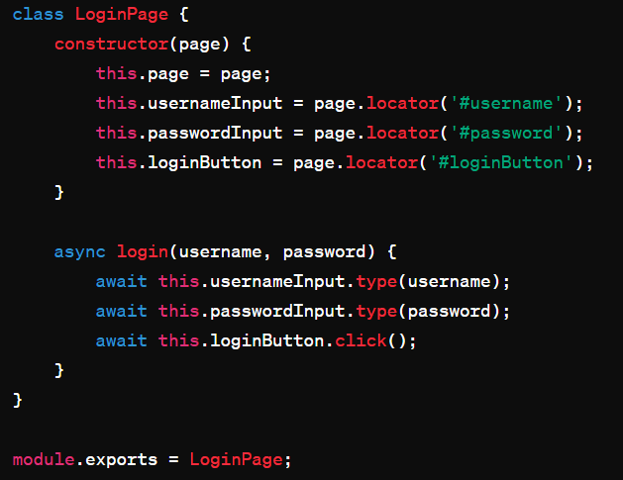
POM Login Class

Slide 256
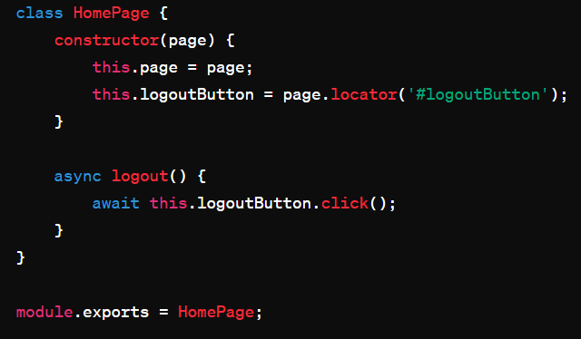
Pom Home Page class

Slide 257
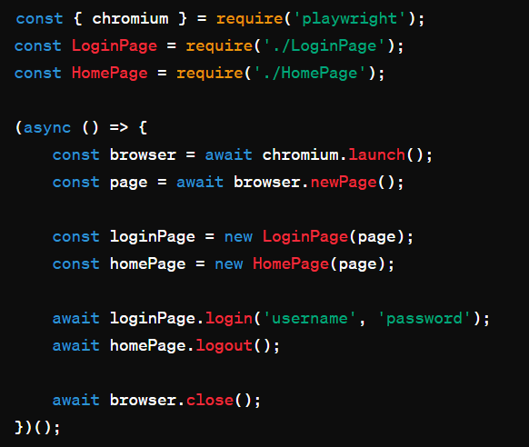
Actual Pom usage

Slide 258
POM Pages in one view

Slide 259
Dealing with flaky tests

Slide 260
Identification of Flaky tests
Monitor test execution for inconsistency or unpredictability in results.
Analyze test logs, screenshots, and error messages to identify patterns of failure.
Use test reporting tools to track test stability and identify flaky tests.

Slide 261
Root Cause Analysis:
Investigate potential causes of flakiness, such as network issues, race conditions, or environmental factors.
Review test code and dependencies for potential sources of instability.
Consider timing-related issues, asynchronous operations, or external dependencies.

Slide 262
Mitigation Strategies:
Implement explicit waits and synchronization mechanisms to ensure test stability.
Retry flaky tests with backoff strategies to reduce the impact of transient failures.
Use test isolation techniques, such as running tests in clean environments or sandboxed contexts.

Slide 263
Collaboration:
Foster collaboration between developers, testers, and stakeholders to address flakiness.
Share knowledge and best practices for writing stable and resilient tests.
Encourage a culture of continuous improvement and collective ownership of test reliability.

Slide 264
Quiz - Code Modularity and Page Objects:
Question: What is the primary goal of using page objects in test automation?
Answer: The primary goal of using page objects is to achieve code modularity and maintainability by encapsulating page-specific functionality and locators within reusable components.

Slide 265
Page Object Model (POM) Introduction:
Question: What is the Page Object Model (POM) in test automation?
Answer: The Page Object Model (POM) is a design pattern in test automation that promotes the creation of reusable page objects to represent web pages or components. It helps improve test maintainability, readability, and reusability by separating page-specific logic from test scripts.

Slide 266
Dealing with Flaky Tests:
Question: How can you mitigate flaky tests in test automation?
Answer: Flaky tests can be mitigated by implementing strategies such as explicit waits, synchronization mechanisms, retry mechanisms with backoff strategies, test isolation techniques, regular code reviews and refactoring, and fostering collaboration between team members for identifying and addressing root causes of flakiness.

Slide 267
Accessibility, Visual Testing, and Reporting

Slide 268
Introduction to Accessibility Testing:
Accessibility testing ensures that web applications are usable by people with disabilities, such as those with visual, auditory, motor, or cognitive impairments.
It aims to ensure that all users, regardless of their abilities, can access and interact with web content effectively.

Slide 269
Common Accessibility Issues:
Missing or incorrect alternative text for images.
Lack of keyboard navigation support.
Insufficient color contrast for text and background elements.
Inaccessible form fields without proper labels or instructions.
Improper use of headings, landmarks, and ARIA (Accessible Rich Internet Applications) attributes.
Non-semantic HTML markup that affects screen reader compatibility.

Slide 270
Benefits of Accessibility Testing:
Improves usability for all users, including those with disabilities.
Enhances compliance with accessibility standards and regulations.
Helps organizations reach a broader audience and improve user satisfaction.
Reduces legal risks associated with accessibility non-compliance.

Slide 271
Approaches to Accessibility Testing:
Manual Testing: Involves human testers reviewing web content for accessibility issues, using assistive technologies such as screen readers and keyboard navigation.
Automated Testing: Utilizes tools like Playwright to automate accessibility checks, including keyboard navigation, ARIA attributes, color contrast, and semantic markup.

Slide 272
Best Practices for Accessibility Testing:
Familiarize yourself with accessibility standards, such as WCAG (Web Content Accessibility Guidelines).
Incorporate accessibility testing into the development lifecycle, from design to deployment.
Involve users with disabilities in testing to gather real-world feedback.
Use a combination of automated and manual testing approaches to ensure comprehensive coverage.
Continuously monitor and address accessibility issues throughout the development process.

Slide 273
Tools for Accessibility Testing:
Playwright: Provides APIs for automating accessibility checks and interacting with web elements programmatically.
Axe-core: A JavaScript library for automated accessibility testing, integrated with Playwright and other testing frameworks.
Lighthouse: An open-source tool from Google for auditing web page performance, accessibility, and best practices.

Slide 274
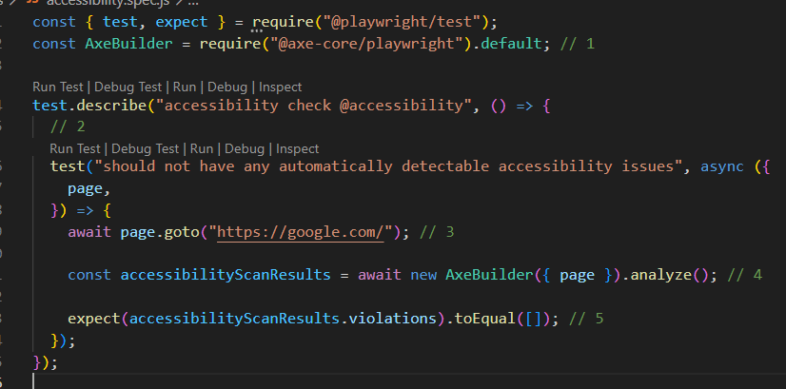
Code

Slide 275
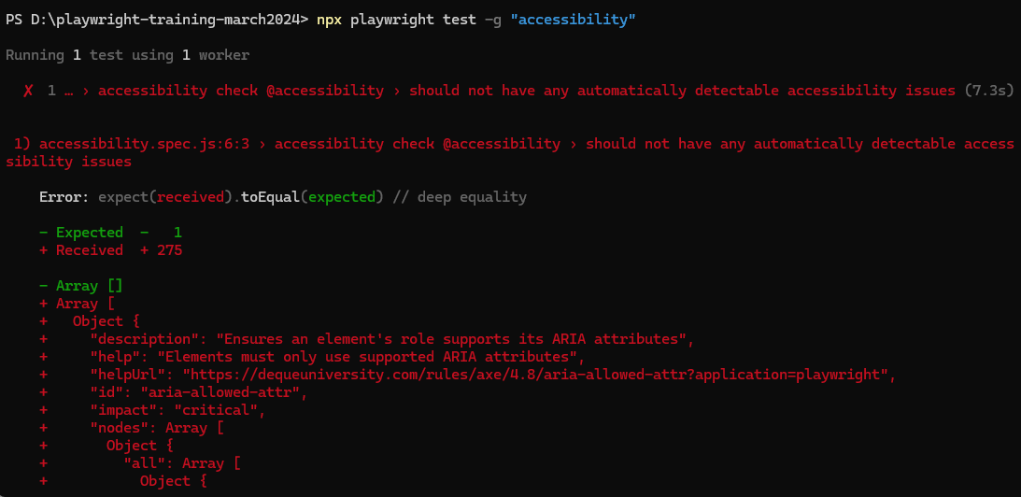
Reporting on command line

Slide 276
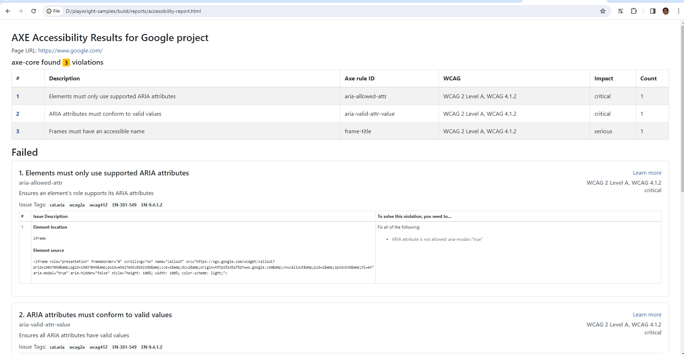

Slide 277
Strict Countries for Accessibility
United States
European Union
Canada
Australia
United Kingdom
Japan

Slide 278
Accessibility compliance

Slide 279

Metrics and Reporting:
Measure accessibility compliance using metrics such as WCAG conformance levels (A, AA, AAA).
Generate accessibility reports with detailed findings, recommendations, and remediation steps for developers.

Slide 280
Visual Regression Testing

Slide 281
Introduction to Visual Regression Testing:
Visual regression testing is a technique used to detect unintended visual changes in web applications between different versions or environments.
It involves capturing screenshots of web pages and comparing them pixel by pixel to identify visual discrepancies.

Slide 282
Common Use Cases:
Detecting layout shifts or styling changes caused by code updates.
Ensuring consistent rendering across browsers, devices, and screen sizes.
Validating changes to UI components, such as buttons, forms, and navigation menus.
Monitoring third-party integrations and dependencies for visual changes.

Slide 283
How Visual Regression Testing Works:
Capture Baseline Screenshots:
Capture Test Screenshots:
Perform Image Comparison:
Identify Differences:
Review and Analyze:

Slide 284
Benefits of Visual Regression Testing:
Helps prevent visual bugs and regressions from reaching production.
Improves UI consistency and user experience by detecting subtle design changes.
Increases confidence in code changes and deployments by validating visual integrity.
Facilitates collaboration between developers, designers, and QA teams by providing visual feedback.

Slide 285
Approaches to Visual Regression Testing:
Automated Testing: Use tools like Playwright with visual regression testing libraries (e.g., Percy, Applitools) to automate screenshot capture and comparison.
Manual Review: Perform manual visual inspections of screenshots to identify discrepancies, especially for complex or dynamic UI elements.
Integration with CI/CD Pipelines: Integrate visual regression tests into your CI/CD pipelines to detect visual changes early in the development process.

Slide 286
Best Practices for Visual Regression Testing:
Establish a Baseline: Create a baseline of screenshots for stable and consistent UI elements.
Define Tolerances: Set tolerance levels for image comparison to account for minor visual differences and avoid false positives.
Maintain Test Coverage: Regularly update and expand visual regression test suites to cover critical UI components and user workflows.
Review and Triaging: Review visual diffs regularly, triage findings, and address legitimate regressions promptly.
Collaboration and Communication: Foster collaboration between development, design, and QA teams to resolve visual discrepancies efficiently.

Slide 287
Tools for Visual Regression Testing:
Playwright: Provides APIs for capturing screenshots and automating visual regression tests across different browsers and devices.
Percy: A visual testing platform that integrates with Playwright to capture and compare screenshots for visual regression testing.
Applitools: A visual AI platform for automated visual testing, offering advanced features like layout testing and cross-browser testing.

Slide 288
Reporting and Continuous Integration

Slide 289
Reporting in Playwright:
Playwright provides built-in support for generating test reports, making it easier to track test results and identify issues.
Different reporting formats are available, including HTML, JSON, and others, allowing flexibility in how test results are presented.
Reports typically include information such as test outcomes (pass/fail), execution times, and error details, enabling developers to quickly diagnose and resolve issues.

Slide 290
Continuous Integration (CI) with Playwright:
Playwright seamlessly integrates with popular CI/CD platforms like Jenkins, Travis CI, CircleCI, and GitHub Actions.
CI pipelines can be configured to automatically trigger Playwright tests whenever changes are pushed to the repository, ensuring that new code is thoroughly tested before deployment.
Playwright's ability to run tests across multiple browsers and environments makes it well-suited for CI workflows, allowing developers to catch cross-browser compatibility issues early in the development cycle.

Slide 291
Key Benefits of Reporting and CI in Playwright:
Visibility: Test reports provide stakeholders with visibility into the overall health of the application and the quality of recent code changes.
Accountability: Detailed test reports hold developers accountable for the quality of their code, encouraging them to write robust tests and address failures promptly.
Rapid Feedback: CI pipelines provide rapid feedback on code changes, allowing developers to identify and fix issues before they escalate.
Automation: Automated testing and reporting streamline the development process, reducing manual effort and enabling faster delivery of high-quality software.

Slide 292
Best Practices for Reporting and CI:
Comprehensive Test Coverage: Ensure that tests cover critical functionality and edge cases to maximize the effectiveness of reporting and CI.
Fast Feedback Loops: Optimize CI pipelines for speed to provide developers with timely feedback on their changes.
Integration with Issue Tracking: Integrate test reports with issue tracking systems like Jira or GitHub Issues to facilitate issue triaging and resolution.
Version Control: Store test reports alongside code changes in version control systems for traceability and historical analysis.
Scheduled Runs: Schedule regular test runs as part of the CI process to continuously monitor application health and detect regressions.

Slide 293
Generating test reports

Slide 294
Built-in Reporting:
Playwright provides built-in support for generating test reports.
You can generate reports in various formats such as HTML, JSON, and others.
Reports typically include information such as test outcomes (pass/fail), execution times, and error details.

Slide 295
Configuring Report Generation:
Configure your test runner (such as Jest or Mocha) to generate reports after test execution.
Specify the desired reporting format (e.g., HTML, JSON) and output directory in your test runner configuration.

Slide 296
Running Tests with Report Generation:
Run your Playwright tests using the configured test runner.
After test execution, the test runner will automatically generate the specified report in the specified output directory.

Slide 297
Analyzing Test Reports:
Once the reports are generated, you can analyze them to gain insights into test results and identify issues.
Look for patterns such as recurring failures or slow-performing tests.
Use the information in the reports to prioritize and address issues in your application code.

Slide 298
Integration with Continuous Integration (CI):
Integrate test report generation into your CI/CD pipeline to automate the process.
Configure your CI tool (e.g., Jenkins, GitHub Actions) to run Playwright tests and generate reports as part of the build process.
This ensures that test reports are automatically generated with each code change, providing continuous visibility into test results.

Slide 299
Quiz - Visual Regression Testing:
Question: What is visual regression testing, and why is it important in web development?
Answer: Visual regression testing involves comparing screenshots of an application's UI before and after changes to detect unintended visual regressions.
It ensures that UI components remain consistent across different versions of an application, preventing layout shifts, styling errors, and other visual inconsistencies.

Slide 300
Reporting and Continuous Integration:
Question: What role do reporting and continuous integration (CI) play in the software development process?
Answer: Reporting provides insights into test results, helping teams identify issues and track progress. Continuous integration (CI) automates the process of building, testing, and deploying code changes, ensuring that applications remain stable and reliable. Together, reporting and CI enable teams to maintain high-quality software and accelerate development cycles.

Slide 301
Generating test reports:
Question: Why is generating test reports important, and how can it be done in Playwright?
Answer: Test reports provide visibility into test results, helping teams identify failures, track progress, and make informed decisions.
In Playwright, test reports can be generated using built-in reporting tools or integrated with third-party services.
Reports typically include information such as test outcomes, execution times, and error details, enabling teams to improve application quality and development processes.

Slide 302
Setting up Playwright with CI/CD (e.g., GitHub Actions):
Question: What are the benefits of setting up Playwright with CI/CD, and how can it be achieved using platforms like GitHub Actions?
Answer: Setting up Playwright with CI/CD enables teams to automate testing and deployment processes, ensuring consistent and reliable application delivery.
With platforms like GitHub Actions, Playwright tests can be integrated into CI/CD pipelines, allowing for automatic execution of tests on code changes and providing immediate feedback to developers.
This improves development efficiency, reduces time-to-market, and enhances overall software quality.

Slide 303
Advanced Topics and Custom Tools

Slide 304
Custom browser contexts
Custom browser contexts in Playwright allow developers to create isolated browsing environments with specific configurations.
Each browser context can have its own set of cookies, storage, permissions, and other settings, providing flexibility in testing scenarios.
Custom browser contexts are useful for simulating different user sessions, testing authentication flows, and isolating test cases.
They can be created using the browser.newContext() method and configured with options such as viewport size, geolocation, and user agent.
Browser contexts can be shared across multiple test cases or disposed of after use to ensure clean test environments.

Slide 305
Devices:
Playwright provides built-in device emulation to simulate various devices and viewports, such as smartphones, tablets, and desktops.
Device emulation allows developers to test how web applications render and behave on different screen sizes and resolutions.
Playwright offers a predefined list of devices with specific viewport dimensions and user agents, including popular devices like iPhone, iPad, and Google Pixel.
Device emulation can be enabled by passing device options to the browser.newContext() method or using the browserContext.emulateDevice() method.
Testing on different devices helps ensure that web applications are responsive and provide a consistent user experience across various platforms and form factors.

Slide 306
Emulating Devices
Built-in Device Emulation:
Viewport and User Agent:
Device Options: Device name or model, viewport size, screen orientation (landscape or portrait), and other device-specific properties.
Viewport and User Agent Override: can override the default viewport size and user agent string to customize the testing environment further.
Viewport Size and Pixel Ratio: device's pixel density (pixel ratio) to accurately render web content. Developers can adjust the pixel ratio

Slide 307
Browser Launch Options:
headless (boolean): Whether to run the browser in headless mode (true for headless, false for headed).
slowMo (number): Slows down Playwright operations by the specified amount of milliseconds. This is useful for debugging and observing the test execution.
args (string[]): Additional command-line arguments to pass to the browser instance.
executablePath (string): Path to the browser executable to use instead of the bundled one.

Slide 308
Launch options
ignoreHTTPSErrors (boolean): Whether to ignore HTTPS errors during navigation.
viewport (ViewportSize): Specifies the initial browser viewport size.
defaultViewport (ViewportSize): Specifies the default viewport size when the browser window is first opened.
userDataDir (string): Path to a user data directory to use for the browser instance.
channel (string): Channel to use for the browser instance (e.g., "chrome", "firefox", "webkit").

Slide 309
Context Options:
User agent
Device emulation
Permissions ex. geolocation
Storage state – sessionStorage, localStorage, cookies etc

Slide 310
permissions
geolocation: Grants or denies access to the Geolocation API.
notifications: Grants or denies the ability to display notifications.
push: Grants or denies the ability to display push notifications.

Slide 311
permissions
camera: Grants or denies access to the camera.
microphone: Grants or denies access to the microphone.
backgroundSync: Grants or denies access to background sync functionality.
ambientLightSensor: Grants or denies access to the ambient light sensor.

Slide 312
permissions
accelerometer: Grants or denies access to the accelerometer.
gyroscope: Grants or denies access to the gyroscope.
magnetometer: Grants or denies access to the magnetometer.
clipboardReadWrite: Grants or denies access to read and write from the clipboard.

Slide 313
Permissions – playwright config
use: {
permissions: {
geolocation: 'granted',
notifications: 'denied',
camera: 'prompt',
microphone: 'prompt',
},

Slide 314
Quiz - Custom Browser Contexts and Devices:
Question: How can you customize browser contexts and devices in Playwright?
Answer: You can define custom browser contexts with specific configurations such as permissions, cookies, and storage isolation.
Additionally, Playwright allows you to emulate various devices like smartphones, tablets, or custom screen sizes for responsive testing.

Slide 315
Quiz - Emulating Devices:
Question: What does emulating devices in Playwright allow?
Answer: Emulating devices in Playwright allows you to simulate the behavior of various devices like smartphones, tablets, or IPADS etc.
This enables you to test how your web application renders and behaves across different screen sizes and device capabilities.

Slide 316
Quiz - Custom Browser Options:
Question: How can you customize browser options in Playwright?
Answer: Playwright provides the flexibility to customize browser options such as launch settings, viewport size, user agent, and browser preferences.
These options allow you to tailor the browser environment to match specific testing scenarios and requirements.

Slide 317
DEbugging

Slide 318
Debugging in Windows Powershell
You can use –debug parameter to debug the playwright test case, it opens the inspector window
npx playwright test --grep --% "@submit" --headed --project=chromium –debug

Slide 319
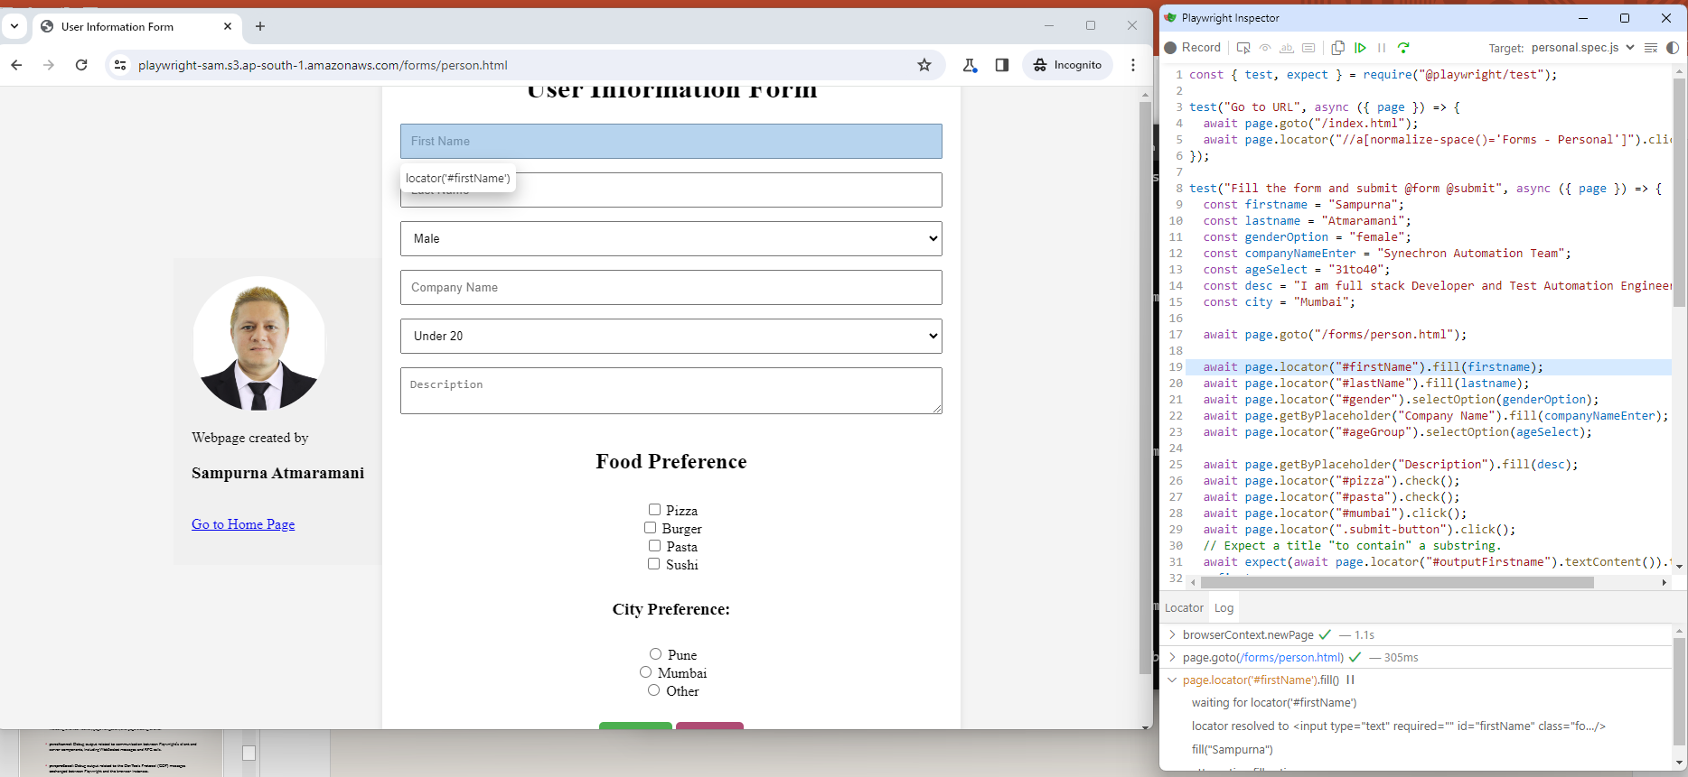
Inspect window

Slide 320
Debugging
You can also set the environment variable
$env:PWDEBUG=1
Step 2 Execute any command
npx playwright test --grep --% "@addition" --headed --project=chromium
It will halt the execution on browser debugger

Slide 321
Various debug options
//Start Debugging in powershell
$env:DEBUG="pw:browser"
$env:DEBUG="pw:channel"
$env:DEBUG="pw:protocol"
$env:DEBUG="pw:rpc"
$env:DEBUG="pw:api"
$env:DEBUG="pw:verbose"
$env:DEBUG="pw:network"

Slide 322
Various debug options
pw:browser: Debug output related to the browser instances managed by Playwright, including browser launch, page navigation, and page closing events.
pw:channel: Debug output related to communication between Playwright's client and server components, including WebSocket messages and RPC calls.
pw:protocol: Debug output related to the DevTools Protocol (CDP) messages exchanged between Playwright and the browser instances.

Slide 323
Various debug options
pw:rpc: Debug output related to Remote Procedure Calls (RPC) between Playwright's client and server components.
pw:api: Debug output related to Playwright's JavaScript API, including method calls and their parameters.
pw:verbose: Enables verbose debug output, providing more detailed information compared to other debug options.
pw:network: Debugging with pw:network is like becoming a detective in the world of web requests and responses.

Slide 324
//Remove Debugging in power shell
//Remove Debugging in power shell
Remove-Item Env:\DEBUG

Slide 325
Passing Debug option
npx playwright test –debug

Slide 326
Code Generator

Slide 327
Code Generator Command
Syntax
Option 1 => npx playwright codegen [HIT ENTER and then enter the url on browser]
Option 2 => npx playwright codegen <URL>
Ex.
npx playwright codegen demo.playwright.dev/todomvc
npx playwright codegen google.com

Slide 328
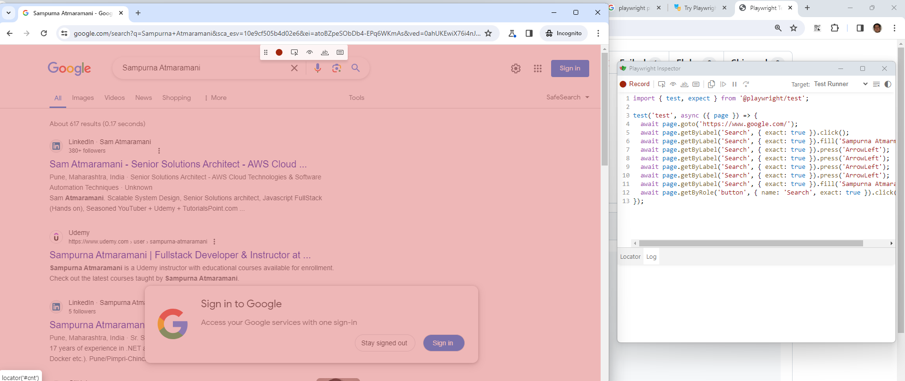
CodeGen auto generated program

Slide 329
Trace

Slide 330
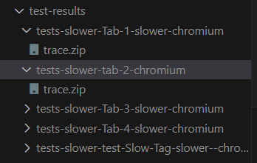
trace
Command to trace
1. npx playwright test --trace on
2. npx playwright test --grep --% "@slower" --headed --project=chromium --workers=1 --trace on
Example command to check trace logs
npx playwright show-trace test-results\tests-slower-Tab-1-slower-chromium\trace.zip

Slide 331
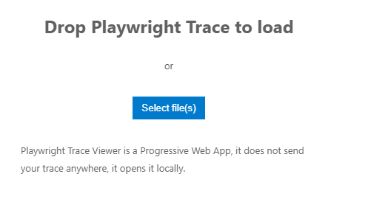
Trace online
You can alternatively go to https://trace.playwright.dev/
Upload the trace file and view the tracing

Slide 332
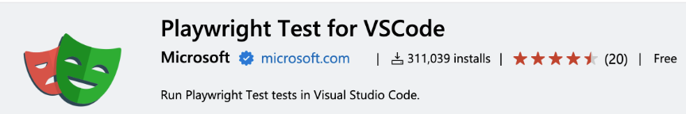
Run tests in VS Code
Install below extension in VS code

Slide 333
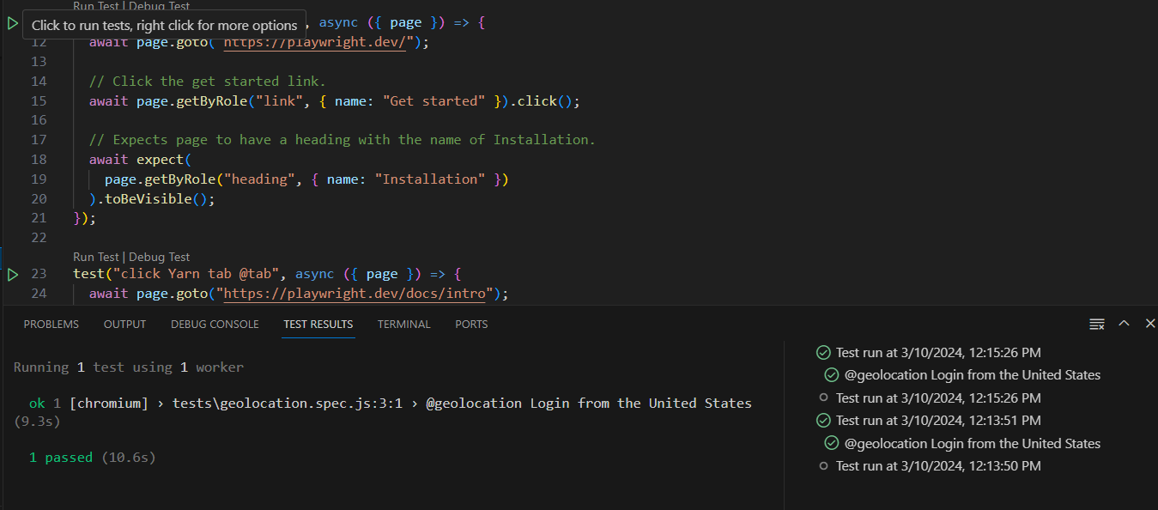
Run test IN VS code

Slide 334
Context options
recordVideo (RecordVideoOptions): Records a video of the browser's execution.
npx playwright test --project=chromium --trace on -g "@recordvideo" --headed --workers=2
recordHar (RecordHarOptions): Records a HAR (HTTP Archive) file of network traffic.
viewport (ViewportSize): Specifies the initial browser viewport size.
userAgent (string): Specifies the user agent string to use for the browser context.
locale (string): Specifies the locale to use for the browser context.

Slide 335
Context Option
timezoneId (string): Specifies the timezone to use for the browser context.
permissions (string[]): Specifies the list of permissions to grant for the browser context.
geolocation (GeolocationOptions): Specifies the geolocation coordinates to use for the browser context.
httpCredentials (HTTPCredentials): Specifies HTTP credentials to use for the browser context.
deviceScaleFactor (number): Specifies the device scale factor to use for the browser context.
isMobile (boolean): Specifies whether the browser context should emulate a mobile device.

Slide 336
Devices
Desktop:
Desktop Chrome
Desktop Firefox
Desktop Safari
Desktop Edge
Mobile:

Slide 337
Phones
iPhone 12
Pixel 5
Galaxy S20
iPad Mini
Nexus 7
iPhone SE

Slide 338
Tablets:
iPad
iPad Pro
iPad Mini

Slide 339
Grep commands
npx playwright test --grep "Addition"
npx playwright test --grep "calculations.spec.js"
Basic Usage: You can use --grep followed by a string to match against the descriptions or names of tests.
Example: --grep "login"

Slide 340
Grep commands
Regular Expressions: You can use regular expressions to match test descriptions or names.
Example: --grep "/login|signup/"
Case Insensitive Match: Use the i flag after the regular expression to perform a case-insensitive match.
Example: --grep "/login|signup/i"

Slide 341
Grep commands
Negation: Use ! to negate the match, meaning tests that don't match the pattern will be executed.
Example: --grep "!login"
Matching Test Files: You can also use --grep to match test filenames.
Example: --grep "login.spec"

Slide 342
Grep commands
Matching Entire Test Path: Match the entire test file path.
Example: --grep "/path/to/test/login.spec"
Matching Entire Test Path and Test Name: Match both the test file path and the test name.
Example: --grep "/path/to/test/login.spec::testLogin"

Slide 343
Grep commands
Excluding Specific Tests: Use ! to exclude specific tests from being executed.
Example: --grep "!login" --grep "signup"
Combining Multiple Patterns: You can combine multiple --grep options to filter tests based on multiple patterns.
Example: --grep "login" --grep "signup"

Slide 344
Example commands
npx playwright test --grep --% "@geolocation" --project=chromium --headed
//to run only two type of tagged tests
npx playwright test --grep --% "@fast^|@tab2"
//it should open browser using --headed option
npx playwright test --grep --% "@fast^|@tab2" --headed

Slide 345
commands
//it should only run on chrome browser
npx playwright test --grep --% "@fast^|@tab2" --headed --project=chromium
//run multiple tests based on one common tag
npx playwright test --grep --% "@calculations" --headed --project=chromium
npx playwright test --grep --% "@fast^|@tab2" --headed --project=smoke
npx playwright test --grep --% "@fast^|@tab2" --headed --project=prod

Slide 346
commands
//run for two projects
npx playwright test test --grep --% "@fast^|@tab2" --headed --project=MobileSafari --project=MobileChromeViewPort
//run on multi devices settings
npx playwright test test --grep --% "@fast^|@tab2" --headed --project=mutipleDevices
@geolocation
npx playwright test test --grep --% "@geolocation" --headed --project=mutipleDevices

Slide 347
commands
//sample command to run with other options
npx playwright test --project=chromium --headed --reporter dot --timeout 30000 --workers 4 --forbid-only --retries 3 --max-failures 5
//download tag
npx playwright test --grep "@download" --project=chromium

Slide 348
commands
//With trace mode on
npx playwright test --grep --% "@slower" --headed --project=chromium --workers=1 --trace on
//run as per text name presence
npx playwright test -g "calculat“
npx playwright test -g "addition"

Slide 349
100 Terminologies
Playwright: An open-source automation library developed by Microsoft for testing web applications across different browsers.
Automation Testing: The process of using software tools to execute pre-scripted tests on software applications automatically.
Web Application: An application accessed and interacted with through a web browser over a network.
Test Script: A set of instructions written in code to simulate user interactions and verify functionality in an application.
Browser Automation: Automating tasks within web browsers such as navigation, form filling, and interaction with elements

Slide 350
100 Terminologies
Cross-Browser Testing: Testing web applications across different browsers to ensure compatibility and consistent behavior.
Headless Browser: A web browser without a graphical user interface, allowing automated browsing and testing in the background.
Test Framework: A set of guidelines, standards, and tools used for creating and executing tests in a structured manner.
Test Runner: A component of the test framework that executes test scripts and reports results.
Test Suite: A collection of test cases or test scripts that are executed together as a group.

Slide 351
100 Terminologies
Selector: A pattern used to identify and locate elements within a web page, such as CSS selectors or XPath expressions.
Page Object Model (POM): A design pattern for organizing and maintaining automated test scripts by representing web pages as objects.
Element Locator: A mechanism used to locate and interact with specific elements on a web page during automation testing.
DOM (Document Object Model): A programming interface that represents the structure of web documents as a tree of objects.
UI Automation: The process of simulating user interactions with the graphical user interface of an application.

Slide 352
100 Terminologies
Browser Context: An isolated environment within a web browser where web pages are loaded and scripts are executed.
Device Emulation: Simulating different devices (e.g., mobile phones, tablets) to test the responsiveness of web applications.
Events: Actions or occurrences that can be detected and handled by automated tests, such as mouse clicks or keyboard input.
Assertions: Statements in test scripts that verify whether specific conditions or expectations are met during testing.
Test Runner Configuration: Settings and options that control the behavior of the test runner during test execution.

Slide 353
100 Terminologies
Parallel Execution: Running multiple tests simultaneously to reduce test execution time and improve efficiency.
Test Coverage: The extent to which the functionality of an application is exercised by automated tests.
Continuous Integration (CI): A development practice where code changes are automatically tested and integrated into a shared repository.
Continuous Delivery (CD): A software development practice where code changes are automatically prepared for release to production.
DevOps: A set of practices that combine software development (Dev) and IT operations (Ops) to streamline the software delivery process.

Slide 354
100 Terminologies
API (Application Programming Interface): A set of rules and protocols that allows different software applications to communicate with each other.
CLI (Command-Line Interface): A text-based interface used to interact with software by entering commands and parameters.
CI/CD Pipeline: A series of automated steps that code changes go through, from development to production deployment.
GitHub Actions: A feature of GitHub that allows users to automate workflows and CI/CD pipelines directly from their repositories.
Browser Compatibility Testing: Testing web applications to ensure they work correctly across different browsers and browser versions.

Slide 355
100 Terminologies
Automated Regression Testing: Re-running automated tests to verify that recent changes to the codebase have not introduced new defects.
Continuous Testing: Testing practices integrated throughout the software development lifecycle, from development to deployment.
Puppeteer: A Node.js library for automating tasks in Chromium-based web browsers, similar to Microsoft Playwright.
WebDriver: A W3C specification and API for automating web browsers, often used in conjunction with Selenium for testing.
Element Interactions: Actions performed on web page elements during automation testing, such as clicking, typing, or scrolling.

Slide 356
100 Terminologies
Mocking: Simulating external dependencies or components to isolate and test specific parts of an application.
User Authentication Testing: Testing the process of user login and authentication within a web application.
Performance Testing: Evaluating the speed, responsiveness, and stability of a web application under different conditions.
Load Testing: Assessing the performance of a web application by subjecting it to simulated user traffic and load.
Accessibility Testing: Ensuring that web applications are usable by people with disabilities and conform to accessibility standards.

Slide 357
100 Terminologies
Test Data Management: Managing and generating data used in automated tests, such as input values and expected outcomes.
Code Coverage: Measuring the percentage of code lines or branches covered by automated tests.
Test Report: A document or summary generated after test execution, containing details of test results and failures.
Debugging: The process of identifying, analyzing, and fixing defects or errors in software code.
Error Handling: Strategies and techniques for detecting and recovering from errors encountered during test execution.

Slide 358
100 Terminologies
Continuous Monitoring: Monitoring the performance and health of applications in real-time, often used in conjunction with automated testing.
Test Environment: The hardware, software, and network configuration in which automated tests are executed.
Test Data Dependency: The reliance of automated tests on specific data or conditions in the test environment.
Test Suite Management: Organizing and maintaining collections of automated tests, including categorization and prioritization.
Test Data Driven Testing (DDT): A testing approach where test scenarios are executed with multiple sets of input data.

Slide 359
100 Terminologies
TestNG: A testing framework for Java that supports various testing types, including unit, functional, and integration testing.
Codeless Automation: A method of test automation that allows tests to be created and executed without writing code.
Test Case Management: Managing individual test cases, including creation, execution, and tracking of results.
Test Environment Provisioning: Setting up and configuring test environments, including hardware, software, and network resources.
Docker: A platform for developing, shipping, and running applications in containers, often used for creating consistent test environments.

Slide 360
100 Terminologies
Kubernetes: An open-source platform for automating deployment, scaling, and management of containerized applications.
Continuous Deployment (CD): A software development practice where changes are automatically deployed to production environments after passing automated tests.
Test Fixture: A set of preconditions or initial states that must be established before executing a test case.
Snapshot Testing: A testing technique that captures the current state of an application and compares it to a reference state to detect changes.
Test Automation Framework: A set of guidelines, standards, and tools used for creating and executing automated tests in a structured manner.

Slide 361
100 Terminologies
Test Plan: A document outlining the objectives, scope, approach, and resources for testing a software application.
Visual Testing: A testing technique that verifies the appearance and layout of web pages to ensure consistency across different browsers and devices.
Dependency Injection: A design pattern where dependencies are passed into a class or function from external sources, often used in testing to inject mock objects.
Test Driven Development (TDD): A development approach where tests are written before implementing code, guiding the design and implementation process.
Behavior Driven Development (BDD): A development approach where tests are expressed in natural language that describes the behavior of the application, often used in conjunction with automation tools like Playwright.

Slide 362
100 Terminologies
Test Prioritization: Ranking and ordering automated tests based on factors such as criticality, risk, and frequency of failure.
Test Execution: The process of running automated tests against a software application to verify its behavior and functionality.
Test Harness: A set of tools, libraries, and utilities used to automate the execution of tests and collect test results.
Test Maintenance: Updating and adapting automated tests to keep pace with changes in the software application or its environment.
Test Data Generation: Automatically creating data sets for testing purposes, including input values and expected outcomes.

Slide 363
100 Terminologies
Test Orchestration: Coordinating and managing the execution of automated tests across multiple environments and configurations.
Test Automation Engineer: A professional responsible for designing, implementing, and maintaining automated tests and testing frameworks.
Test Repository: A centralized storage location for storing and managing automated tests, including version control and access control.
Test Strategy: A high-level plan outlining the approach, objectives, scope, and resources for testing a software application.
Test Coverage Analysis: Evaluating the extent to which automated tests exercise different parts of the software application, such as code lines, branches, and paths.

Slide 364
100 Terminologies
Test Suite Execution: Running a collection of automated tests together as a group to verify the behavior and functionality of a software application.
Test Result Analysis: Analyzing the output and outcomes of automated tests to identify defects, trends, and areas for improvement.
Test Refactoring: Restructuring and optimizing automated tests to improve readability, maintainability, and efficiency.
Test Deployment Pipeline: A series of automated steps that code changes go through, from development to deployment, including building, testing, and deployment stages.
Test Design Pattern: A reusable solution or template for organizing and structuring automated tests to address common testing challenges and scenarios.

Slide 365
100 Terminologies
Test Case Prioritization: Ranking and ordering individual test cases within a test suite based on factors such as criticality, risk, and likelihood of failure.
Test Environment Configuration: Setting up and configuring test environments, including hardware, software, and network settings, to ensure consistency and reproducibility of test results.
Test Discovery: Identifying and locating automated tests within a codebase or test repository, including categorization and classification based on attributes such as functionality, complexity, and ownership.
Test Harness Development: Designing, implementing, and maintaining a set of tools, libraries, and utilities used to automate the execution of tests and collect test results.
Test Dependency Management: Managing dependencies and interdependencies between automated tests, including establishing and maintaining test execution order, data dependencies, and environment dependencies.

Slide 366
100 Terminologies
Test Result Visualization: Visualizing and presenting the output and outcomes of automated tests in a clear and comprehensible manner, including dashboards, reports, and charts.
Test Coverage Reporting: Reporting on the extent to which automated tests exercise different parts of the software application, such as code lines, branches, and paths, including metrics, trends, and analysis.
Test Execution Monitoring: Monitoring the progress and status of automated test execution in real-time, including tracking test progress, detecting failures, and managing test queues and priorities.
Test Failure Analysis: Analyzing and diagnosing failures and defects identified during automated test execution, including root cause analysis, impact assessment, and defect triage.
Test Maintenance Automation: Automating tasks and activities related to maintaining and updating automated tests, including refactoring, regression testing, and test environment provisioning.

Slide 367
100 Terminologies
Test Data Management Automation: Automating tasks and activities related to managing and generating test data, including data extraction, transformation, and loading (ETL), as well as synthetic data generation and masking.
Test Orchestration Automation: Automating tasks and activities related to coordinating and managing the execution of automated tests across multiple environments and configurations, including scheduling, parallelization, and distribution.
Test Result Analysis Automation: Automating tasks and activities related to analyzing and interpreting the output and outcomes of automated tests, including test result aggregation, normalization, and visualization.
Test Reporting Automation: Automating tasks and activities related to generating, formatting, and distributing reports and artifacts produced by automated tests, including report generation, customization, and delivery.
Test Deployment Automation: Automating tasks and activities related to deploying and releasing changes to the software application, including continuous integration (CI), continuous delivery (CD), and deployment pipeline automation.

Slide 368
100 Terminologies
Test Environment Provisioning Automation: Automating tasks and activities related to setting up and configuring test environments, including infrastructure as code (IaC), configuration management, and containerization.
Test Workflow Automation: Automating tasks and activities related to managing and executing the end-to-end testing process, including test planning, execution, monitoring, and reporting, as well as integration with other development and operations processes.
Test Lifecycle Management Automation: Automating tasks and activities related to managing and governing the entire lifecycle of automated tests, including version control, traceability, auditability, and compliance.
Test Integration Automation: Automating tasks and activities related to integrating automated tests with other development and operations tools, systems, and processes, including collaboration, notification, and workflow automation.
Test Optimization Automation: Automating tasks and activities related to optimizing and improving the effectiveness, efficiency, and reliability of automated tests, including performance tuning, resource allocation, and feedback loop optimizatio

Slide 369
Last day Agenda

Slide 370
Agenda
Possible code walk through for various use cases
Explain playwright.config.js => configuration file
Github Actions demo – CI (Continuous integration)
Accessibility Testing
JEST / Mocha / chai integration information

Slide 371
Agenda
Referer test case & code show – Question by Kiran S.
Student Project display and Code explanation
Show the assertions in that project
Quizzes
Discussions / Question – answers
Sign off & Gratitude

Slide 372
Quiz Time

Slide 373
Quiz – Code walk through

Slide 374
Quiz – Code walk through
What is the playwright function to enter input data in text box
Locator.Fill()
What is the function to mimic the checkbox check?
Locator.check()

Slide 375
Quiz - configuration

Slide 376
Quiz - Configurations
By which option we can configure which folder to consider testing files
testDir
Which option is helpful for setting the reporting type
Reporter
True or false : its possible to do tracing only on failures
True

Slide 377
Quiz – Github Actions

Slide 378
Quiz – Github Actions
True or false: we can configure github workflow to run only when somebody pushes the code in the repo, no other option available
False
Github actions is completely paid service
False

Slide 379
Quiz – all topic

Slide 380
Quiz
Which command line option / parameter is used for opening playwright inspector?
--debug
Which line I need to write in code to stop the page execution at some line number for debugging purpose
page.pause()

Slide 381
quiz
True or false : retry will only work on failed test cases
True
True or false: we can integrate mocha framework with playwright
True

Slide 382
quiz
True or false: Accessibility is the way by which we can compare the screenshots
False
True or False: We can verify local server code also using playwright web playground for ex https://try.playwright.tech/?l=javascript&e=crawl-y-combinator
False

Slide 383
quiz
True or false : By default Playwright script runs for unlimited time
False – 30 seconds by default
True or false: global timeout and expect timeout can be different
True – Default global time out is 30 seconds and default expect timeout is 5 seconds

Slide 384
quiz
True or false: we can configure max one retry for any scenario
False – we can configure any number of retries as per our need
True or False: we can create more than one browser context in one test case
True
True or false: in Playwright - considering main frame and iframe on the page, we can either work on iframe or on mainframe – do we need to switch the context
False –we can work on both at the same time holding the object of that mainframe or iframe – we can simultaneously use both

Slide 385
Quiz
True OR false :- Playwright allows third party reporting
True
True or False :- Its not possible to take screenshots in Playwright
False
True of False :- Playwright have Electron browser also in built
False

Slide 386
Quiz
True OR false :- Playwright has different API’s for all 3 different browsers
False
True or False :- Playwright runs on only Headed mode (always opens browser)
False
True of False :- We can intercept Network request and response using Playwright
True

Slide 387
Quiz
True or False :- chaining starts from one
False
True of False :- We need to compulsorily run our code on all the available browsers
False
True OR false :- We can do tagging and run only selected test cases
True

Slide 388
Quiz
Question: What is the purpose of the page.goto function in a test script?
Answer: The page.goto function navigates the browser to a specified URL, allowing us to start our test from a specific web page.

Slide 389
Quiz
Question: How do you make assertions about the behavior of your application in a Playwright test script?
Answer: expect

Slide 390
Quiz
Question: What is the purpose of the beforeEach and afterEach hooks in a Playwright test script?
Answer: These hooks allow you to execute setup and teardown logic before and after each test case, ensuring a clean and consistent test environment.

Slide 391
Quiz
Question: Give me a command to execute a Playwright test script using the Playwright CLI (Command Line)
Answer: npx playwright test

Slide 392
Quiz - Drag-and-drop:
Question: give me the function which helps in drag and drop
Answer: You can use the dragTo(target) method to simulate a drag-and-drop operation. Example: await page.locator("#dragElement").dragTo(page.locator("#dropTarget"));

Slide 393
Quiz - Assertions and Testing:
Question: Which assertion libraries can you use with Playwright for writing tests?
Answer: You can use libraries like Jest, Mocha, or Chai for writing assertions in Playwright tests.
Question: How do you assert that an element is visible on the page using Playwright?
Answer: You can use the expect function along with Playwright's isVisible method to assert the visibility of an element.
Example: expect(await page.isVisible('.element')).toBeTruthy().

Slide 394
Quiz - Structuring tests (describe, it blocks):
Question: What is the purpose of the describe block in test scripts?
Answer: The describe block is used to group related test cases together.
Question: How can you execute setup and teardown logic before and after each test case in Playwright tests?
Answer: You can use the beforeEach and afterEach hooks to execute setup and teardown logic before and after each test case within the describe block.

Slide 395


Thank you

